Slide 1

Modern test theory in action
Solving real-world challenges
in psychological measurement
Nils Myszkowski – July 10th, 2025

Slide 2
About me
Associate Professor of Psychology at Pace University, NYC
Teaching : Psychometrics, statistics and research design, in doctoral clinical/school programs, using SPSS (PsyD) and R (PhD)
Main research aim : To improve the measurement of creative potential (and human potential in general), for research, policy and assessment
Research partners : PISA Creative Thinking methods group, Claire Wladis (CUNY, NSF Grant), Martin Storme & Pinar Çelik (IESEG/CNRS, France), Baptiste Barbot (UC Louvain, Belgium)

Slide 3
Occurrence of “Item Response Theory” in Publications on Psychological Assessment with Tests (De Boeck, 2018)

Slide 4
Barriers
(Borsboom, 2006; De Boeck, 2018)
We are rarely interested in individual items…
Classical test theory methods are more accessible…
In simple situations, sum scores are strongly correlated with IRT scores…
Unawareness of real-life assessment
problems that modern test theory can solve
Today’s presentation !

Slide 5
Barriers
(Borsboom, 2006; De Boeck, 2018)
We are rarely interested in individual items…
Classical test theory methods are more accessible…
In simple situations, sum scores are strongly correlated with IRT scores…
Unawareness of real-life assessment
problems that modern test theory can solve
Today’s presentation !

Slide 6
Today’s presentation
Solving real-world challenges in psychological measurement
A primer on modern test theory: More than a set of rules
Accommodating non-standard formats: Generalized models
Boosting reliability with distractors: Nested logit models
Disentangling response processes: IRTree models
Going beyond answers: Joint hierarchical models
Conclusions and upcoming plans

Slide 7
A primer on modern test theory:
More than a set of rules
Notes:
6 MIN

Slide 8
What do test theories do ?
Psychology 🧠
Behavior ✍️
Unobserved construct
(e.g., has high anxiety)
Observed item response
(e.g., answers “4-Agree” to “I often worry.”)

Slide 9
What do test theories do ?
Psychology 🧠
Behavior ✍️
Unobserved construct
(e.g., has high anxiety)
Observed item response
(e.g., answers “4-Agree” to “I often worry.”)
🔗

Slide 10
What do reflective test theories do ?
Psychology 🧠
Behavior ✍️
Unobserved construct
(e.g., has high anxiety)
Observed item response
(e.g., answers “4-Agree” to “I often worry.”)
🔗

Slide 11
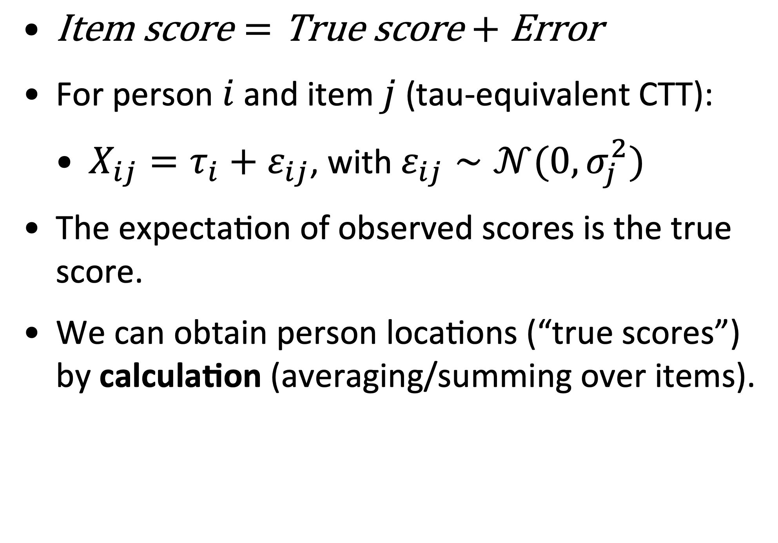
Classical Test Theory (CTT)
An axiomatic approach to psychometrics
$\text{Item} \text{score}=\text{True} \text{score}+\text{Error}$
For person $i$ and item $j$ (tau-equivalent CTT):
$X_{ij}=τ_{i}+ε_{ij}$, with $ε_{ij}∼𝒩(0,σ_{j}^{2})$
The expectation of observed scores is the true score.
We can obtain person locations (“true scores”) by calculation (averaging/summing over items).

Slide 12
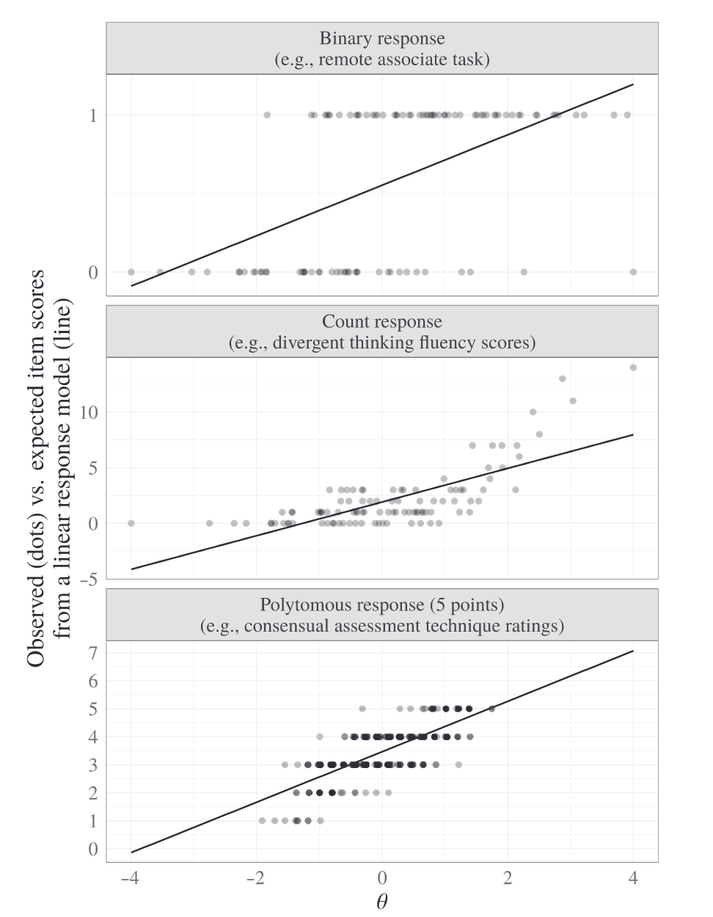
Some problems
Linear/Gaussian issues
Assumes:
A linear relation between the attribute and expected item scores
Normally distributed item scores with fixed variance
Not always reasonable !
Myszkowski (2024)

Slide 13
What about modern response theory?
Notes:
6 MIN

Slide 14
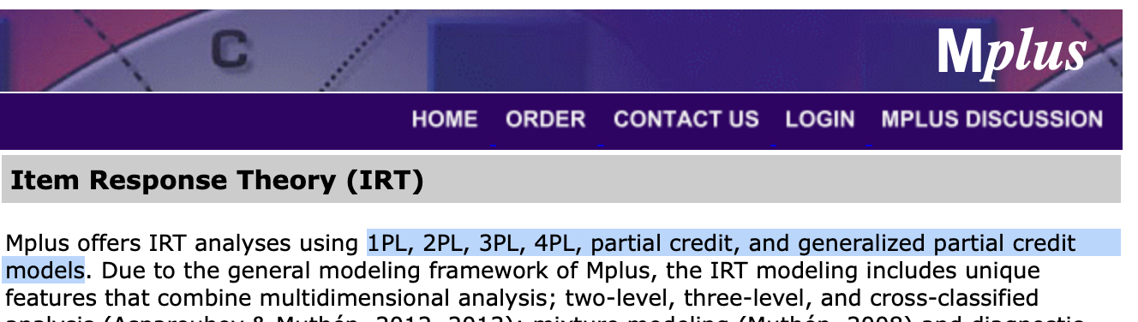
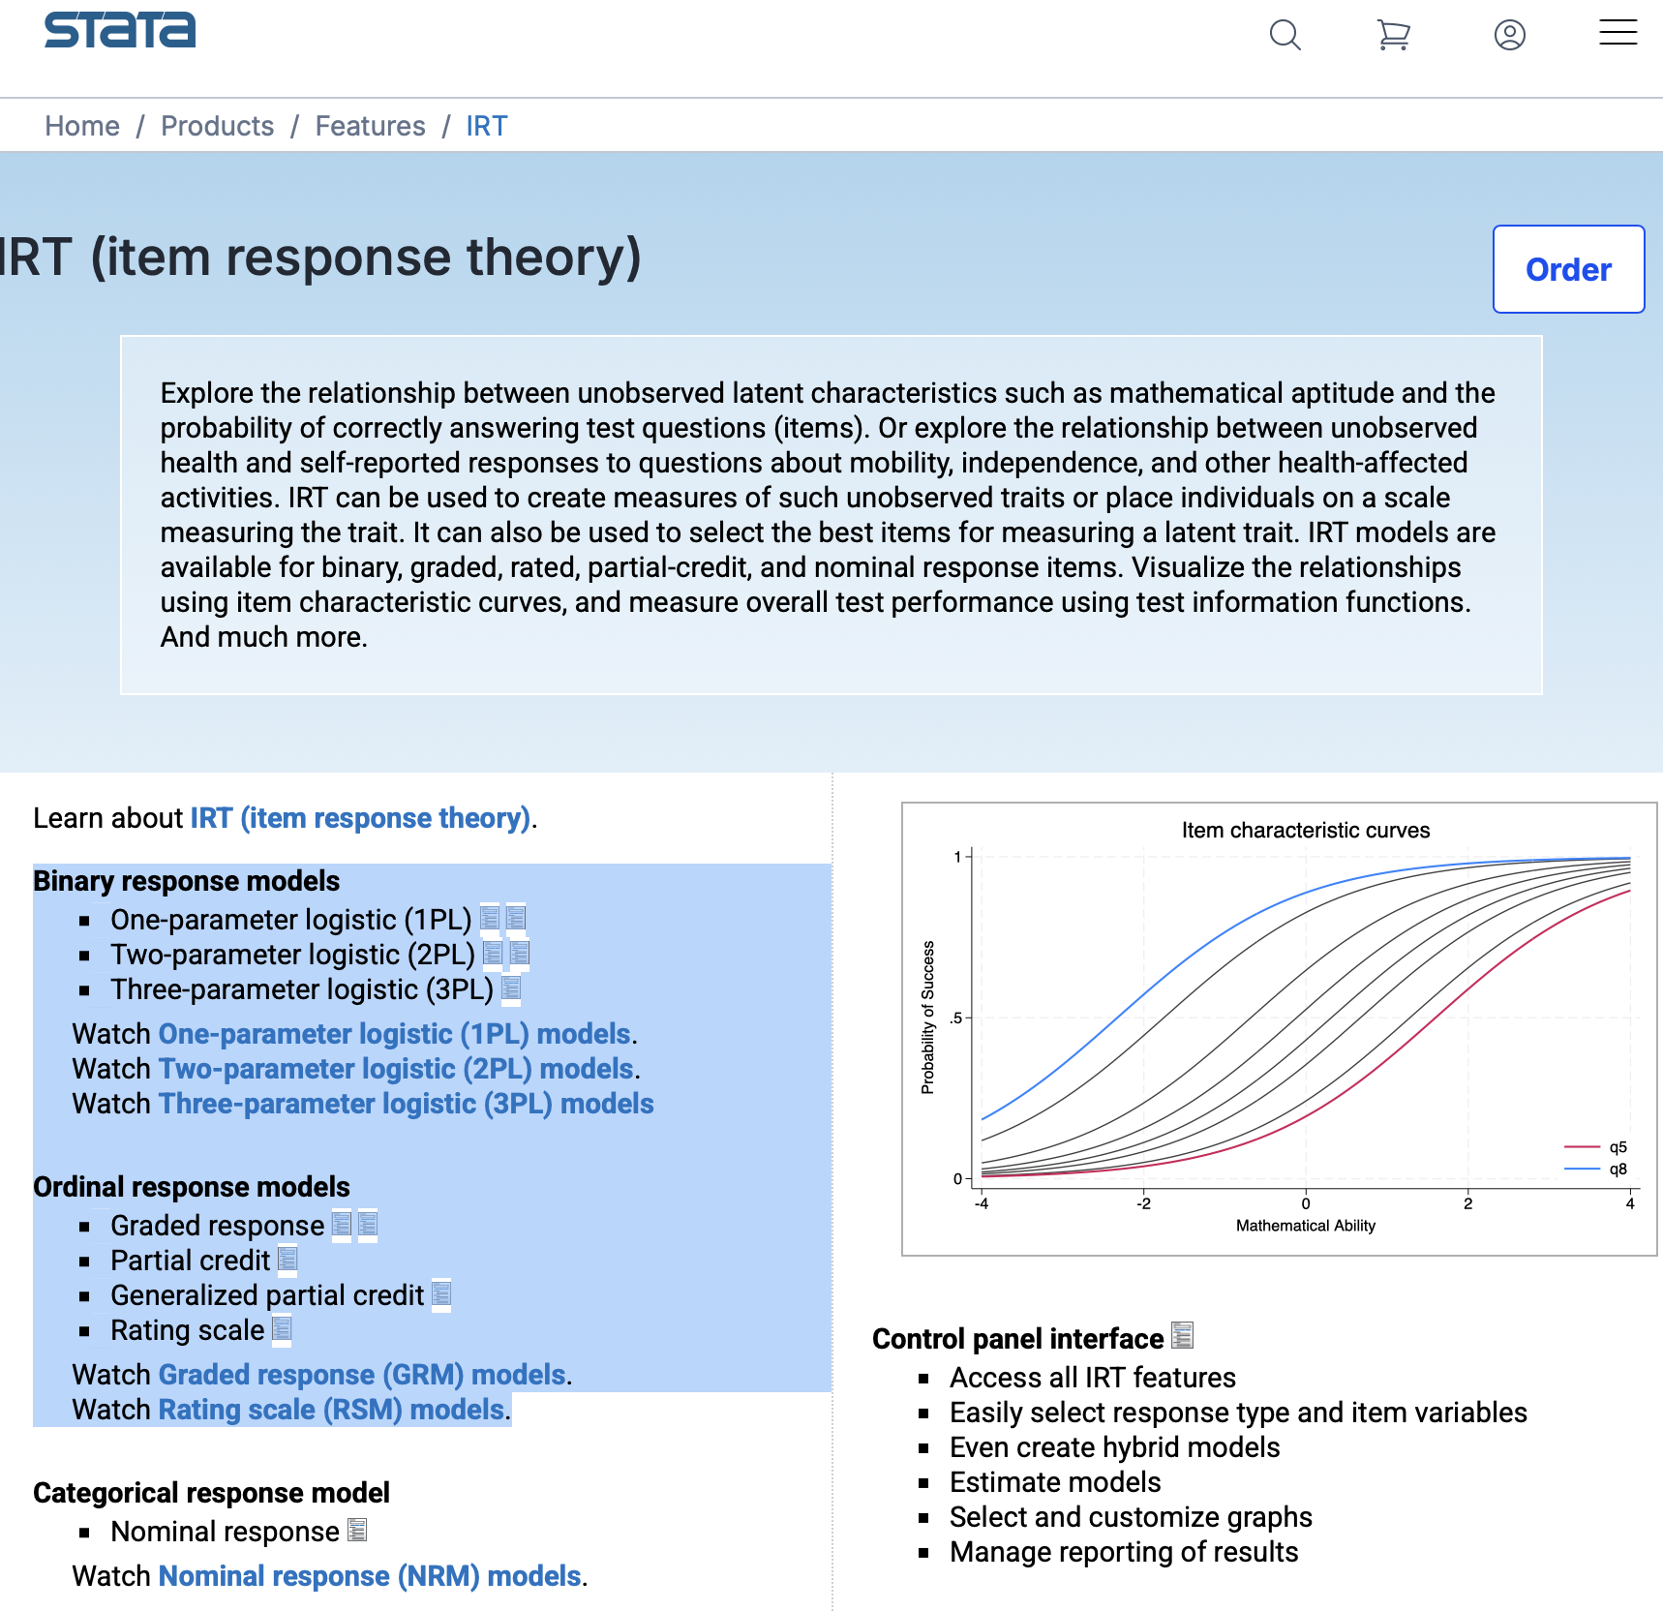
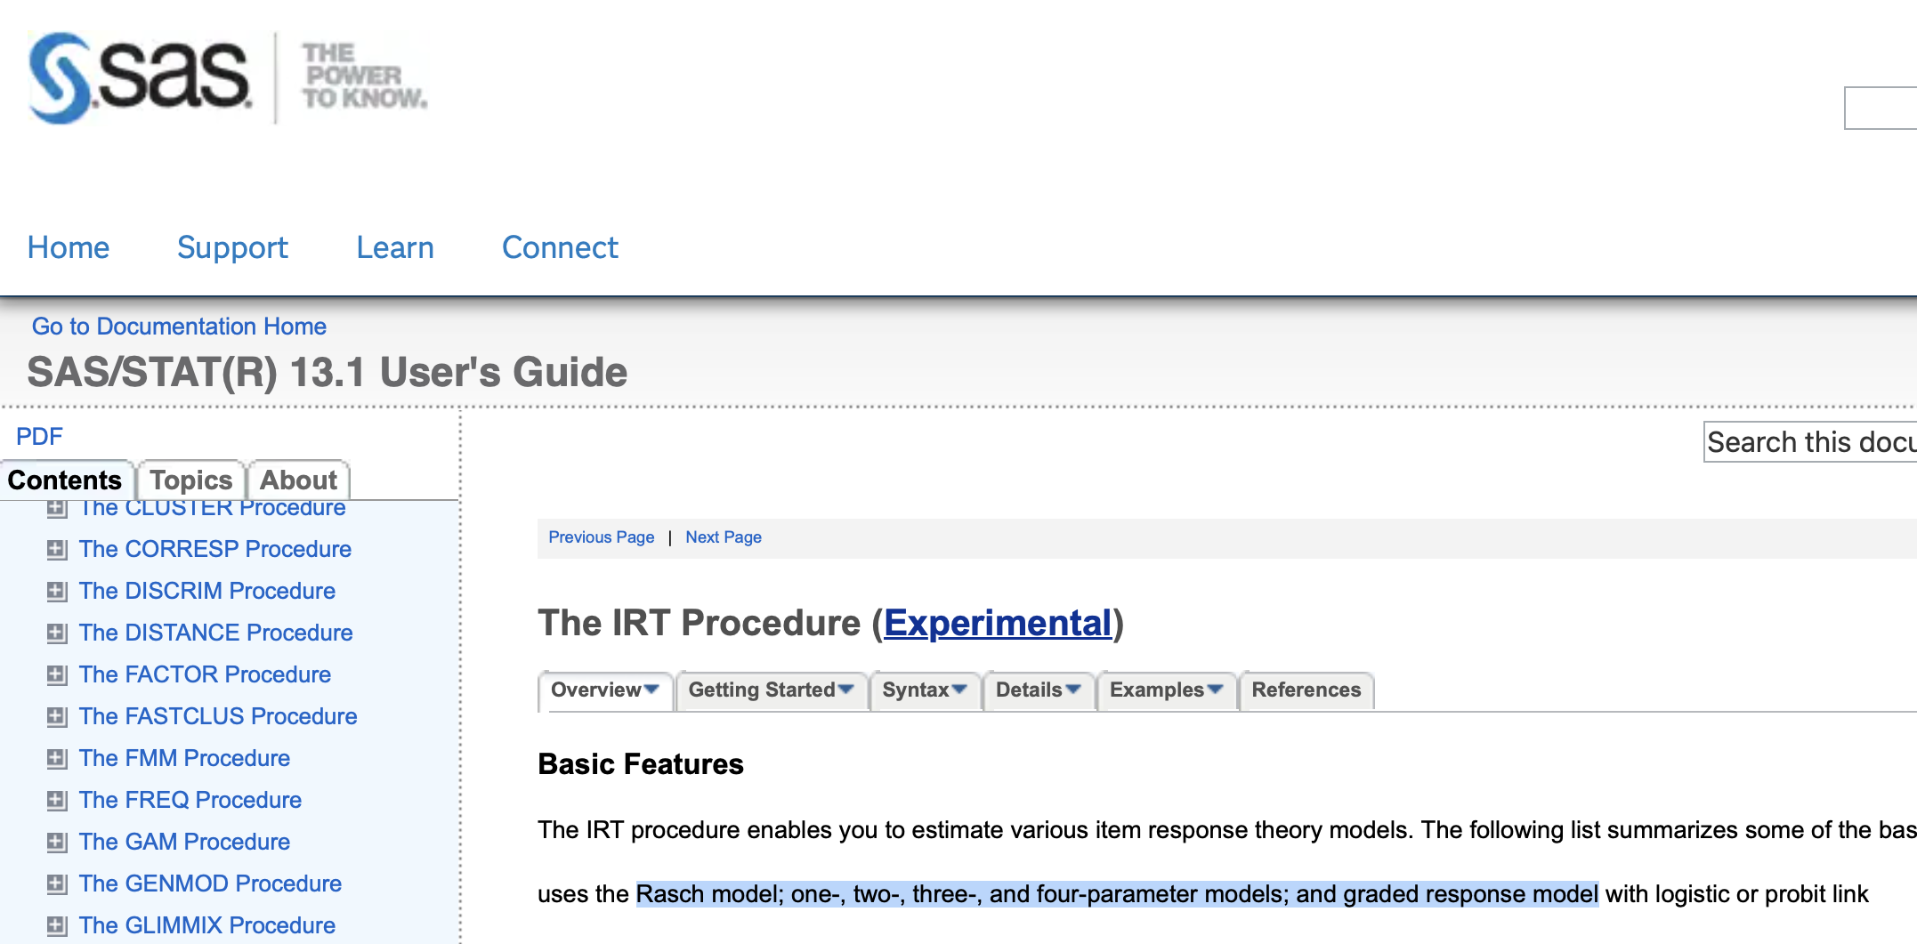

Slide 15
Modern test theory / item response theory (IRT)
A probabilistic approach to psychometrics
IRT “is like the theory of statistical estimation. IRT uses latent characterizations of individuals and items as predictors of observed responses.” (De Ayala, 2022, p.5).
Conceptual shift: from rationalizing scoring procedures to proposing a probabilistic explanation for item scores.
Requires statistical estimation to obtain person locations.

Slide 16
Anatomy of an IRT model
(in general)
Probability
distribution
Item response function
Specifies
Generates
Distribution parameter(s)
= f (
Person
attribute(s)
,
Item characteristic(s)
)
Item scores
Allow
to estimate

Slide 17
Anatomy of an IRT model
(in general)
Probability
distribution
Item response function
Specifies
Generates
Distribution parameter(s)
= f (
Person
attribute(s)
,
Item characteristic(s)
)
Item scores
Allow
to estimate

Slide 18
Anatomy of an IRT model
(in general)
Probability
distribution
Item response function
Specifies
Generates
Distribution parameter(s)
= f (
Person
attribute(s)
,
Item characteristic(s)
)
Item scores
Allow
to estimate

Slide 19
Anatomy of an IRT model
(in general)
Probability
distribution
Item response function
Specifies
Generates
Distribution parameter(s)
= f (
Person
attribute(s)
,
Item characteristic(s)
)
Item scores
Allow
to estimate

Slide 20
Anatomy of an IRT model
(in general)
Probability
distribution
Item response function
Specifies
Generates
Distribution parameter(s)
= f (
Person
attribute(s)
,
Item characteristic(s)
)
Item scores
Allow
to estimate

Slide 21
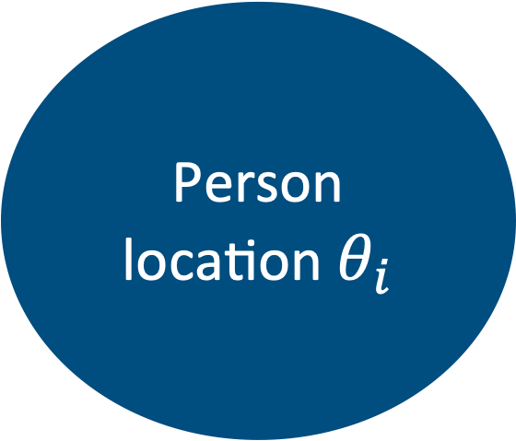
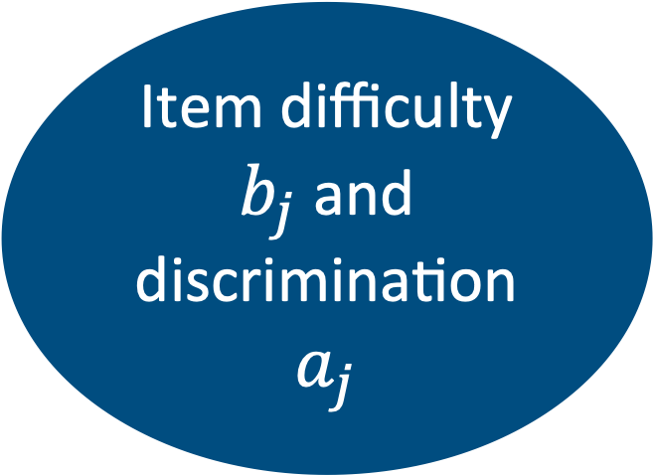
Anatomy of an IRT model
Example : 2-parameter logistic $X_{ij}∼\text{Bernoulli} \left({\text{logit}}^{−1}(a_{j}θ_{i}+b_{j})\right)$
Bernoulli distribution
Item response function
Specifies
Generates
Probability parameter
= f (
Person
location $θ_{i}$
,
Item difficulty $b_{j}$ and discrimination $a_{j}$
)
Binary item scores
(0, 0, 1, 0, etc.)
Allow
to estimate

Slide 22
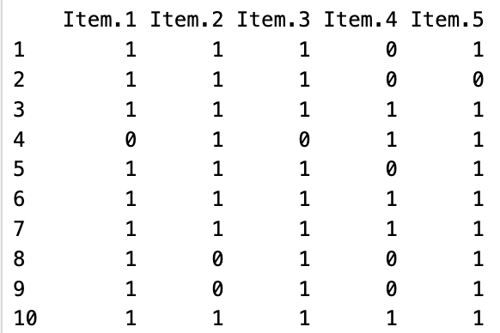
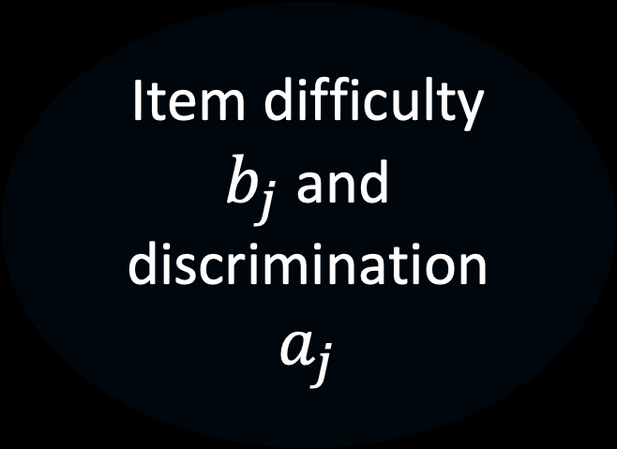
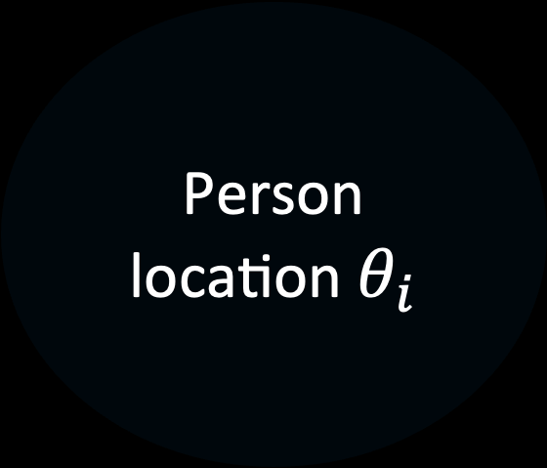
Anatomy of an IRT model
Example : 2-parameter logistic $X_{ij}∼\text{Bernoulli} \left({\text{logit}}^{−1}(a_{j}θ_{i}+b_{j})\right)$
Bernoulli distribution
Item response function
Specifies
Generates
Probability parameter
= f (
Person
location $θ_{i}$
,
Item difficulty $b_{j}$ and discrimination $a_{j}$
)
Binary item scores
(0, 0, 1, 0, etc.)
Allow
to estimate

Slide 23
Anatomy of an IRT model
Example : 2-parameter logistic $X_{ij}∼\text{Bernoulli} \left({\text{logit}}^{−1}(a_{j}θ_{i}+b_{j})\right)$
Bernoulli distribution
Item response function
Specifies
Generates
Probability parameter
= f (
Person
location $θ_{i}$
,
Item difficulty $b_{j}$ and discrimination $a_{j}$
)
Binary item scores
(0, 0, 1, 0, etc.)
Allow
to estimate

Slide 24
Anatomy of an IRT model
Example : 2-parameter logistic $X_{ij}∼\text{Bernoulli} \left({\text{logit}}^{−1}(a_{j}θ_{i}+b_{j})\right)$
Bernoulli distribution
Item response function
Specifies
Generates
Probability parameter
= f (
Person
location $θ_{i}$
,
Item difficulty $b_{j}$ and discrimination $a_{j}$
)
Binary item scores
(0, 0, 1, 0, etc.)
Allow
to estimate

Slide 25
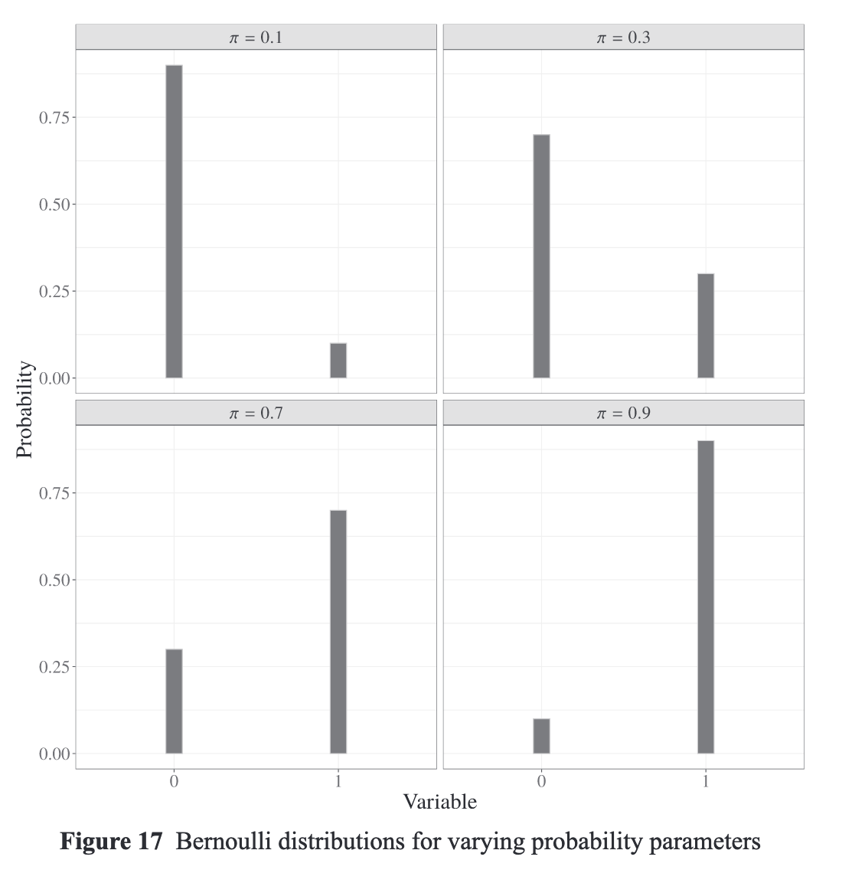
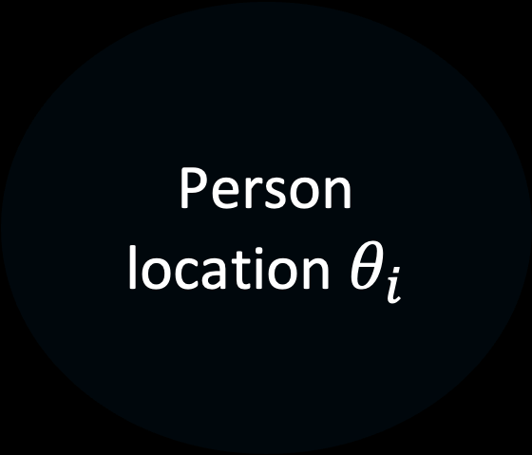
Anatomy of an IRT model
Example : 2-parameter logistic $X_{ij}∼\text{Bernoulli} \left({\text{logit}}^{−1}(a_{j}θ_{i}+b_{j})\right)$
Bernoulli distribution
Item response function
Specifies
Generates
Probability parameter
= f (
Person
location $θ_{i}$
,
Item difficulty $b_{j}$ and discrimination $a_{j}$
)
Binary item scores
(0, 0, 1, 0, etc.)
Allow
to estimate

Slide 26
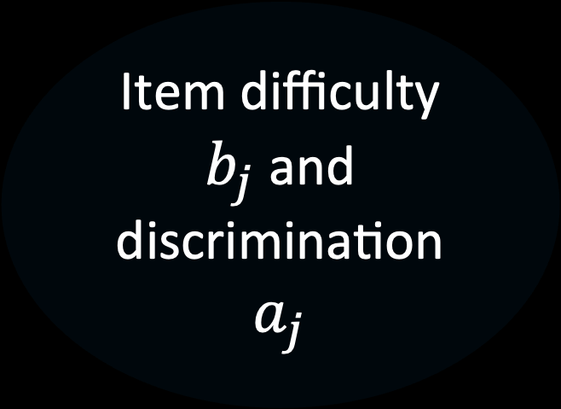
Anatomy of an IRT model
Example : 2-parameter logistic $X_{ij}∼\text{Bernoulli} \left({\text{logit}}^{−1}(a_{j}θ_{i}+b_{j})\right)$
Bernoulli distribution
Item response function
Specifies
Generates
Probability parameter
= f (
Person
location $θ_{i}$
,
Item difficulty $b_{j}$ and discrimination $a_{j}$
)
Binary item scores
(0, 0, 1, 0, etc.)
Allow
to estimate

Slide 27

Anatomy of an IRT model
Example : 2-parameter logistic $X_{ij}∼\text{Bernoulli} \left({\text{logit}}^{−1}(a_{j}θ_{i}+b_{j})\right)$
Bernoulli distribution
Item response function
Specifies
Generates
Probability parameter
= f (
Person
location $θ_{i}$
,
Item difficulty $b_{j}$ and discrimination $a_{j}$
)
Binary item scores
(0, 0, 1, 0, etc.)
Allow
to estimate

Slide 28
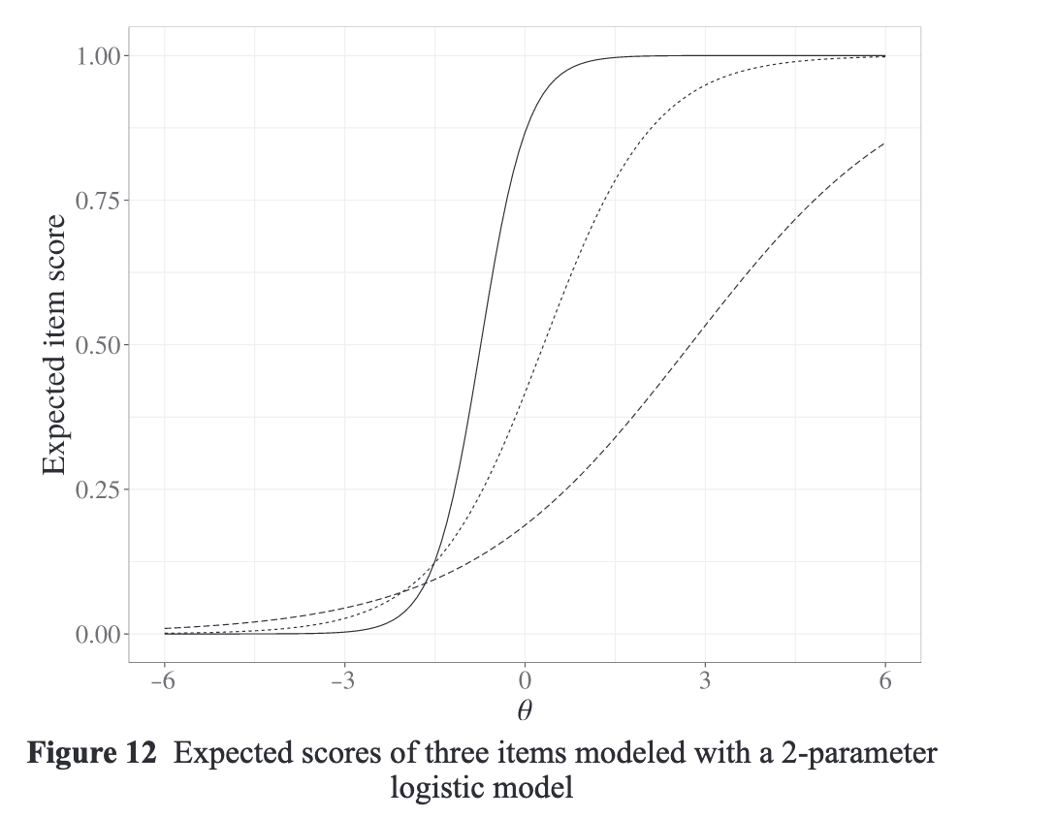
Anatomy of an IRT model
Example : 2-parameter logistic $X_{ij}∼\text{Bernoulli} \left({\text{logit}}^{−1}(a_{j}θ_{i}+b_{j})\right)$
Bernoulli distribution
Item response function
Specifies
Generates
Probability parameter
= f (
Person
location $θ_{i}$
,
Item difficulty $b_{j}$ and discrimination $a_{j}$
)
Binary item scores
(0, 0, 1, 0, etc.)
Allow
to estimate

Slide 29
Anatomy of an IRT model
Example : 2-parameter logistic $X_{ij}∼\text{Bernoulli} \left({\text{logit}}^{−1}(a_{j}θ_{i}+b_{j})\right)$
Bernoulli distribution
Item response function
Specifies
Generates
Probability parameter
= f (
Person
location $θ_{i}$
,
Item difficulty $b_{j}$ and discrimination $a_{j}$
)
Binary item scores
(0, 0, 1, 0, etc.)
Allow
to estimate

Slide 30
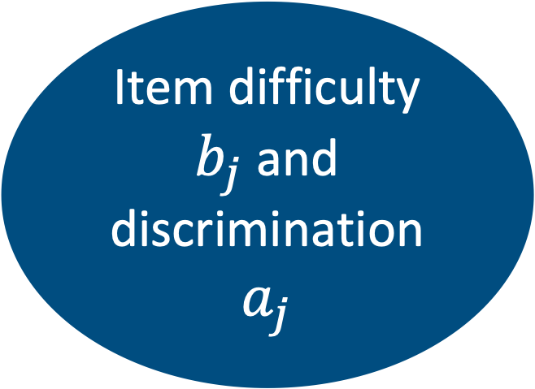
Anatomy of an IRT model
Example : 2-parameter logistic $X_{ij}∼\text{Bernoulli} \left({\text{logit}}^{−1}(a_{j}θ_{i}+b_{j})\right)$
Bernoulli distribution
Item response function
Specifies
Generates
Probability parameter
= f (
Person
location $θ_{i}$
,
Item difficulty $b_{j}$ and discrimination $a_{j}$
)
Binary item scores
(0, 0, 1, 0, etc.)
Allow
to estimate

Slide 31
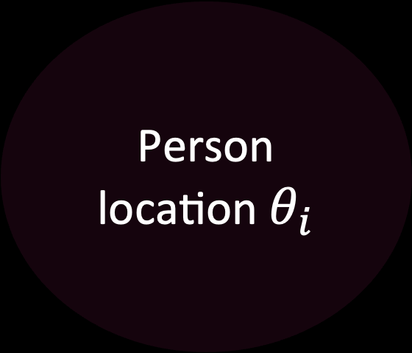
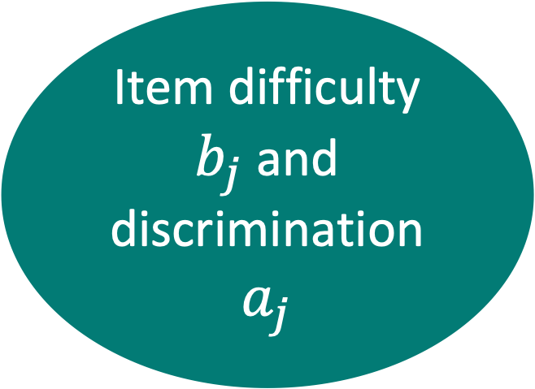
Anatomy of an IRT model
Example : 2-parameter logistic $X_{ij}∼\text{Bernoulli} \left({\text{logit}}^{−1}(a_{j}θ_{i}+b_{j})\right)$
Bernoulli distribution
Item response function
Specifies
Generates
Probability parameter
= f (
Person
location $θ_{i}$
,
Item difficulty $b_{j}$ and discrimination $a_{j}$
)
Binary item scores
(0, 0, 1, 0, etc.)
Allow
to estimate
Assessment or
substantive research
Instrument
development

Slide 32
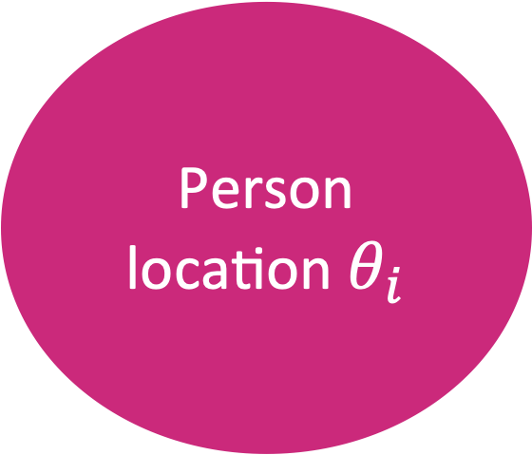
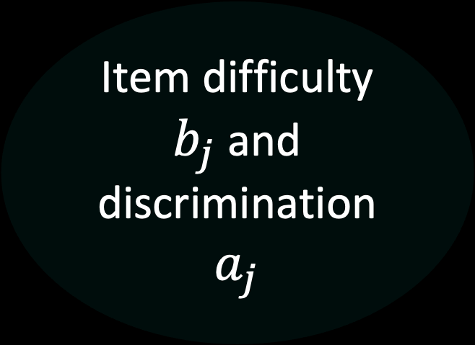
Anatomy of an IRT model
Example : 2-parameter logistic $X_{ij}∼\text{Bernoulli} \left({\text{logit}}^{−1}(a_{j}θ_{i}+b_{j})\right)$
Bernoulli distribution
Item response function
Specifies
Generates
Probability parameter
= f (
Person
location $θ_{i}$
,
Item difficulty $b_{j}$ and discrimination $a_{j}$
)
Binary item scores
(0, 0, 1, 0, etc.)
Allow
to estimate
Assessment or
substantive research
Instrument
development

Slide 33
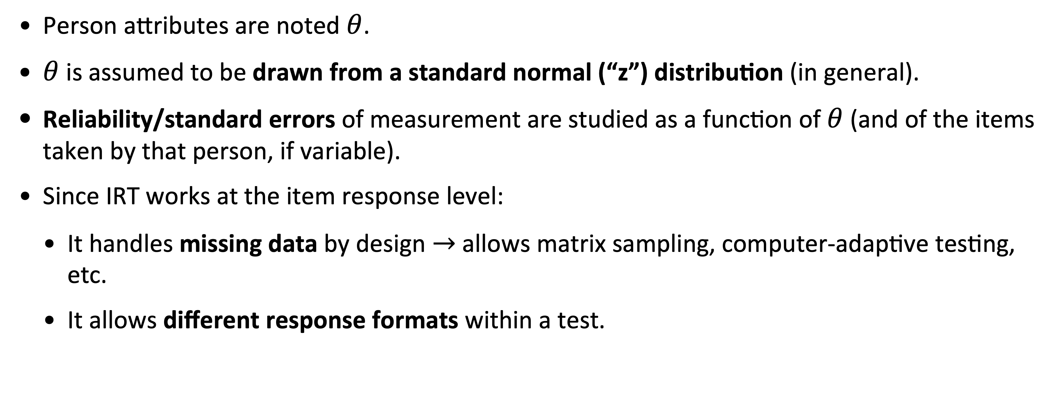
Notes and generalities about IRT
(useful for later)
Person attributes are noted $θ$.
$θ$ is assumed to be drawn from a standard normal (“z”) distribution (in general).
Reliability/standard errors of measurement are studied as a function of $θ$ (and of the items taken by that person, if variable).
Since IRT works at the item response level:
It handles missing data by design $→$ allows matrix sampling, computer-adaptive testing, etc.
It allows different response formats within a test.

Slide 34
Accommodating non-standard formats:
Generalized models
Notes:
15 MIN

Slide 35
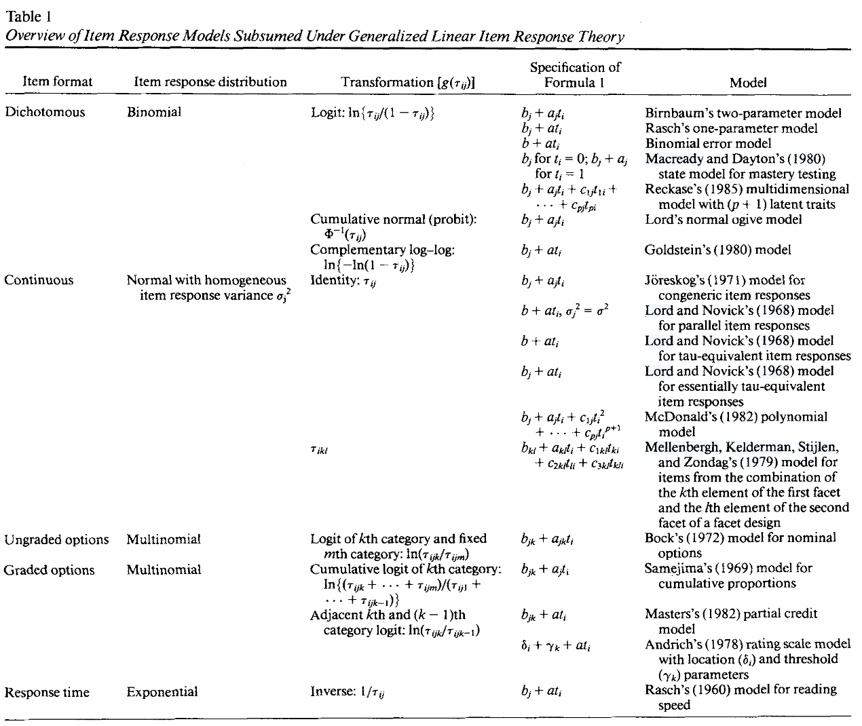
Modern test theory as an approach
Mellenberg (1994)

Slide 36
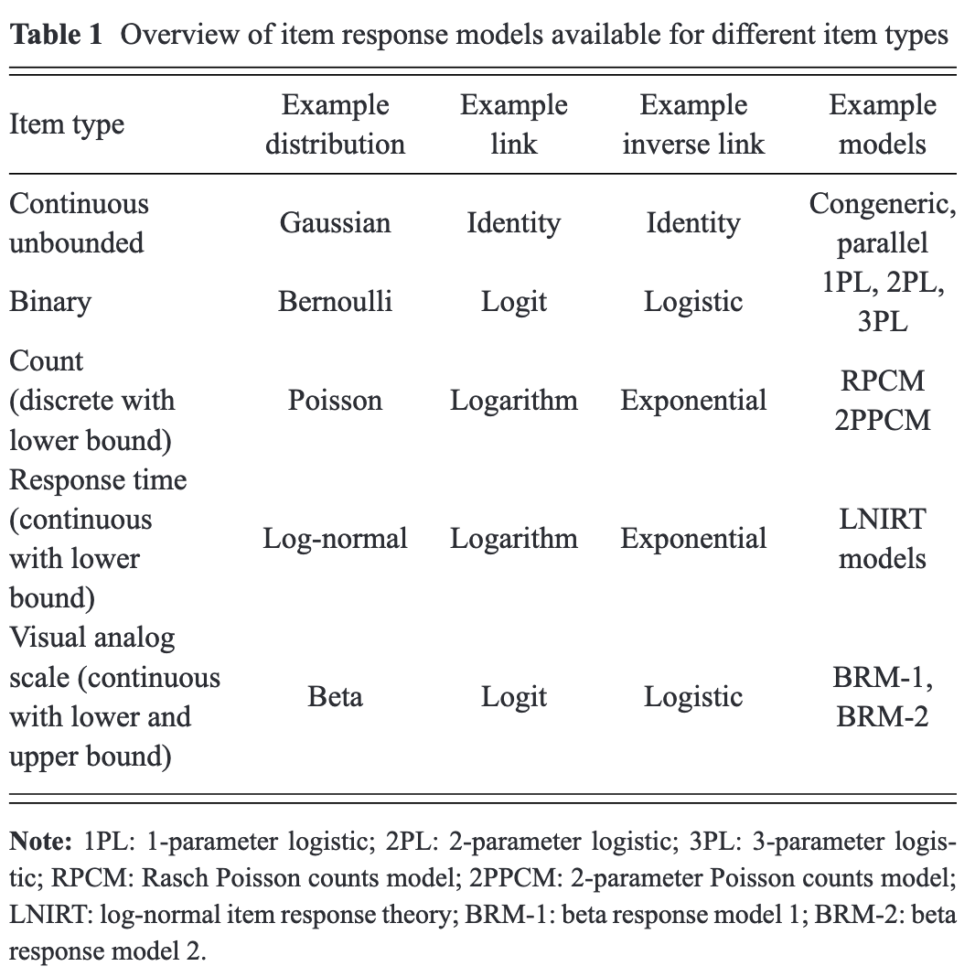
Modern test theory as an approach
Myszkowski (2024)

Slide 37
Modern test theory as an approach
Classical test theory models
Myszkowski (2024)

Slide 38
Modern test theory as an approach
“Common” IRT models
Myszkowski (2024)

Slide 39
Modern test theory as an approach
…and more !
Myszkowski (2024)

Slide 40
Example : Modeling fluency scores
(Myszkowski & Storme, 2021, 2025)
Development of the 2-parameter Poisson counts model (2PPCM; Myszkowski & Storme, 2021) for fluency tests
…and its estimation in a Bayesian multilevel regression framework in R and Stan (Myszkowski & Storme, 2025)
Re-analysis of divergent thinking fluency data (from Silvia et al. 2008; Forthmann et al., 2019)
Alternate uses (e.g., “uses of a brick” 🧱)
Instances (e.g., “things that make a noise” 🔊)
Consequences (e.g., “if people no longer had to sleep” 💤)

Slide 41
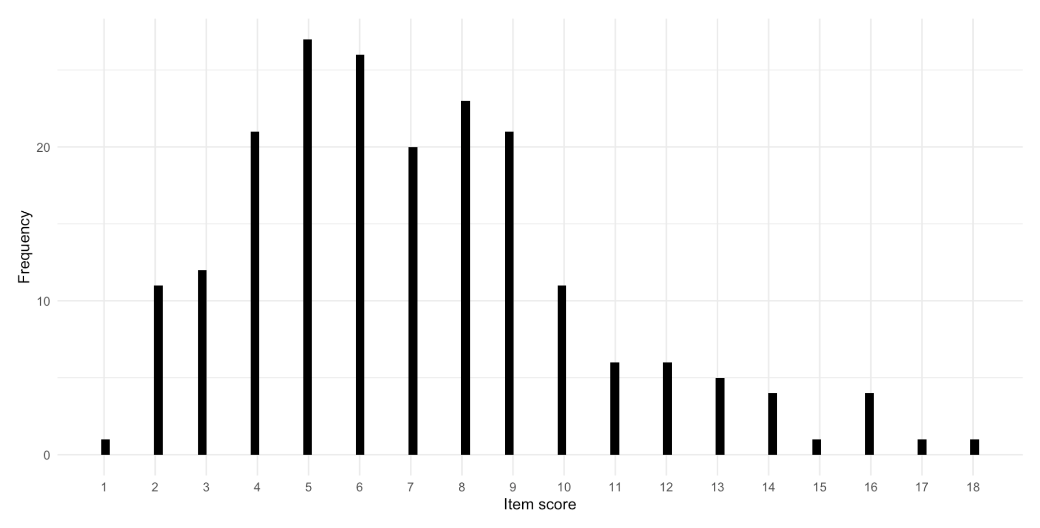

Slide 44
How do we account for these specificities?
Discrete responses with increasing variance ?
Poisson distribution
Floor effect at 0 ?
Exponential response function (i.e. logarithmic link)
…and the typical components of an item response model:
Item effects : Difficulty and discrimination
Person effects : Person fluency

Slide 45
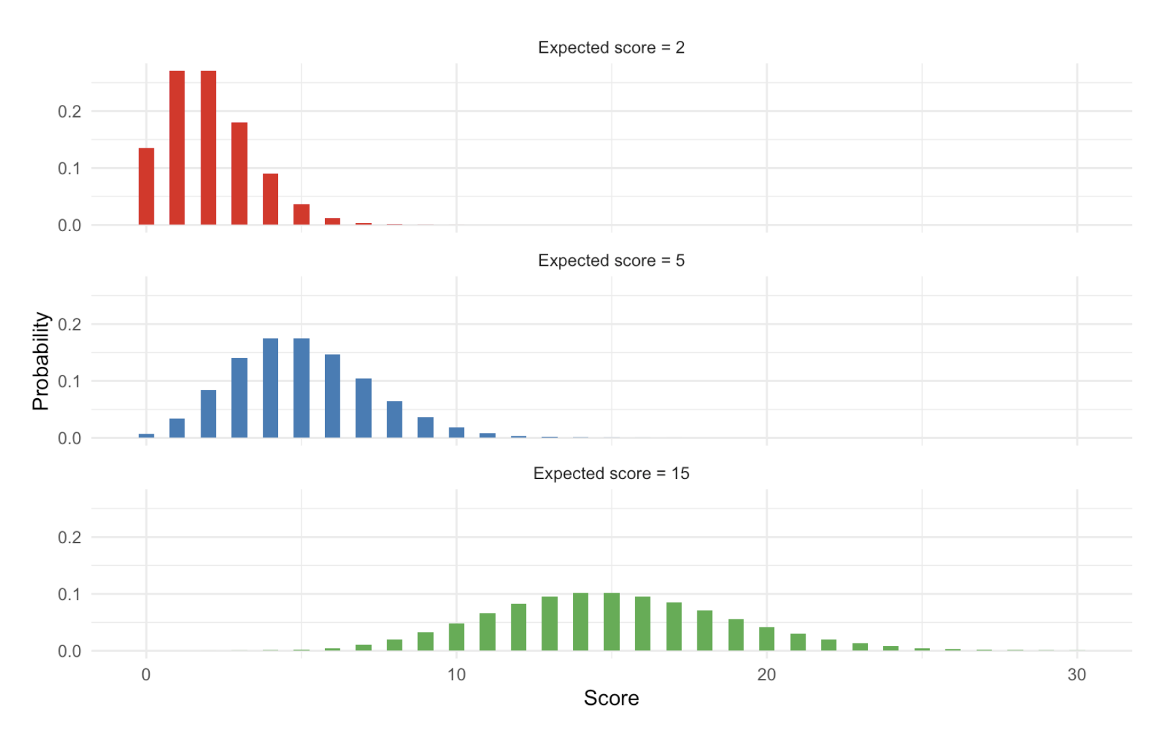
Myszkowski, 2025

Slide 46
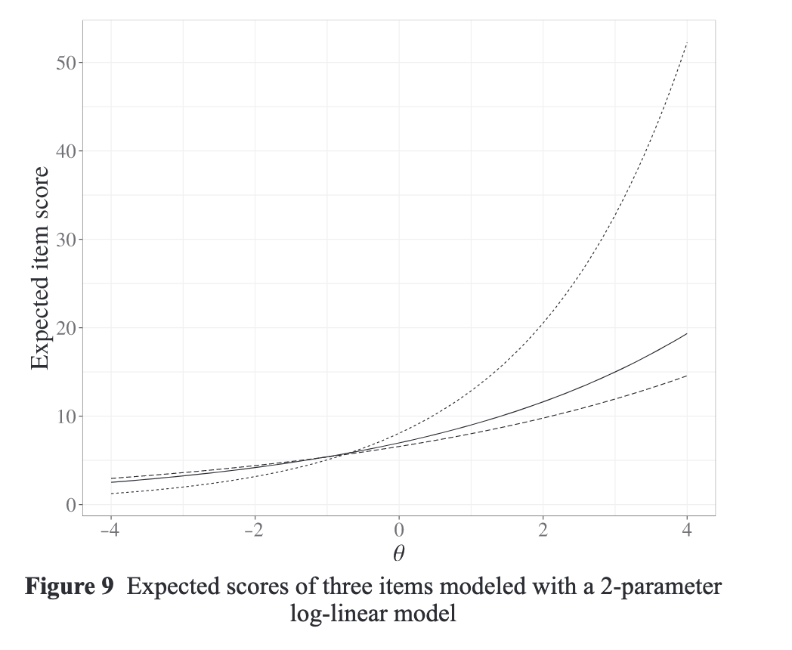
Myszkowski, 2024

Slide 47
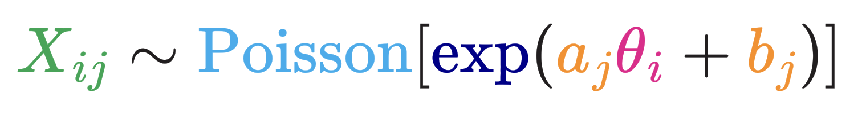
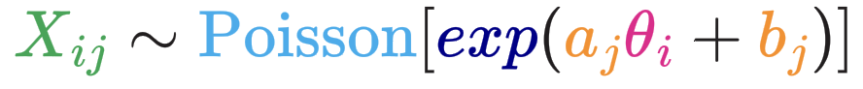
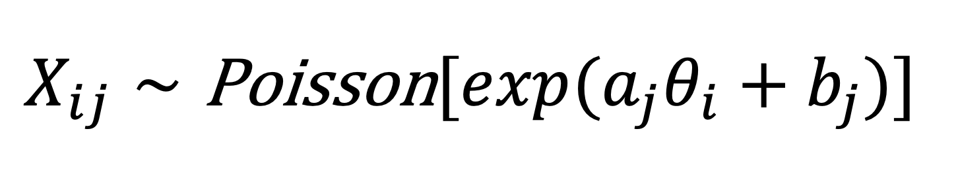
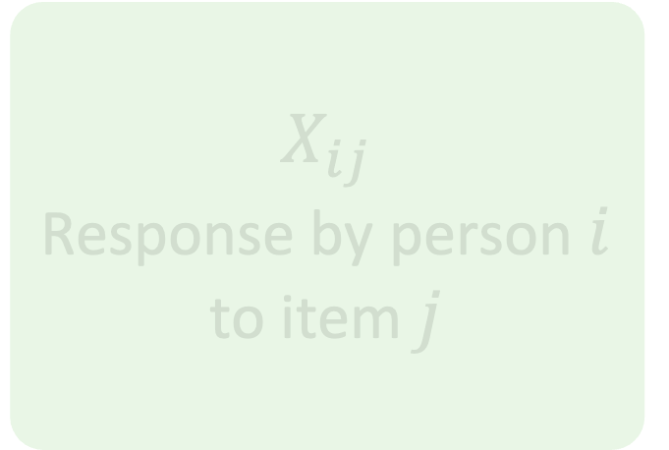
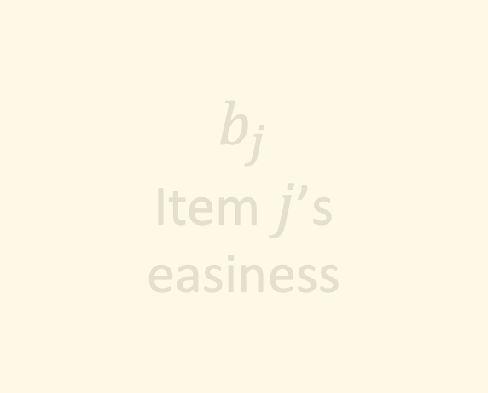
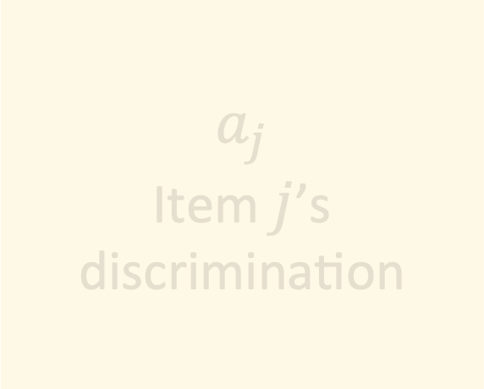
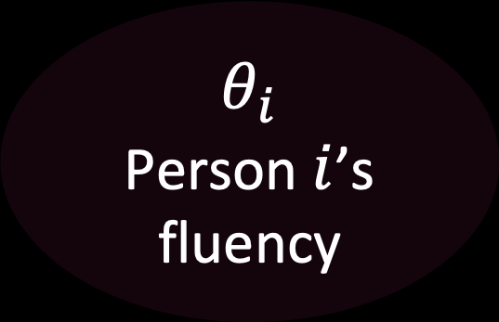
The 2-parameter Poisson counts model
$$θ_{i}$$
Person $i$’s
fluency
Exponential inverse link
$$X_{ij}$$
Response by person $i$ to item $j$
$$a_{j}$$
Item $j$’s discrimination
$$b_{j}$$
Item $j$’s
easiness
Poisson probability distribution
$$X_{ij}∼\text{Poisson}[exp(a_{j}θ_{i}+b_{j})]$$

Slide 48
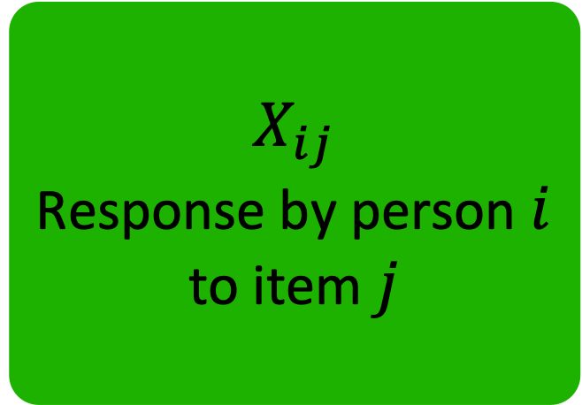
The 2-parameter Poisson counts model
$$θ_{i}$$
Person $i$’s
fluency
Exponential inverse link
$$X_{ij}$$
Response by person $i$ to item $j$
$$a_{j}$$
Item $j$’s discrimination
$$b_{j}$$
Item $j$’s
easiness
Poisson probability distribution
$$X_{ij}∼\text{Poisson}[exp(a_{j}θ_{i}+b_{j})]$$

Slide 49

The 2-parameter Poisson counts model
$$θ_{i}$$
Person $i$’s
fluency
Exponential inverse link
$$X_{ij}$$
Response by person $i$ to item $j$
$$a_{j}$$
Item $j$’s discrimination
$$b_{j}$$
Item $j$’s
easiness
Poisson probability distribution
$$X_{ij}∼\text{Poisson}[exp(a_{j}θ_{i}+b_{j})]$$

Slide 50
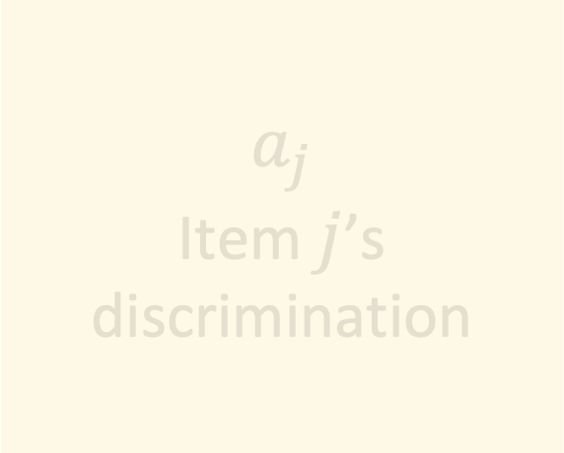
The 2-parameter Poisson counts model
$$θ_{i}$$
Person $i$’s
fluency
Exponential inverse link
$$X_{ij}$$
Response by person $i$ to item $j$
$$a_{j}$$
Item $j$’s discrimination
$$b_{j}$$
Item $j$’s
easiness
Poisson probability distribution
$$X_{ij}∼\text{Poisson}[exp(a_{j}θ_{i}+b_{j})]$$

Slide 51
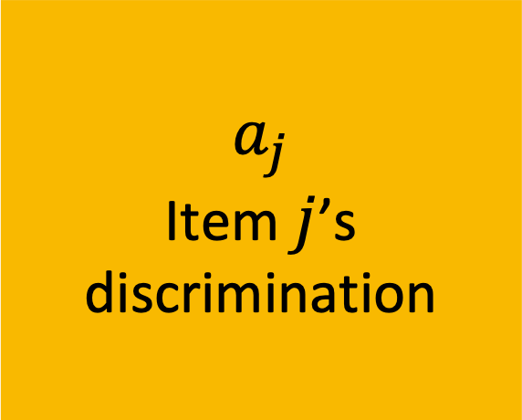
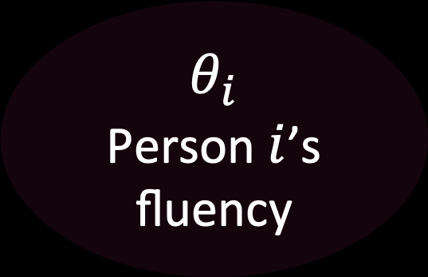
The 2-parameter Poisson counts model
$$θ_{i}$$
Person $i$’s
fluency
Exponential inverse link
$$X_{ij}$$
Response by person $i$ to item $j$
$$a_{j}$$
Item $j$’s discrimination
$$b_{j}$$
Item $j$’s
easiness
Poisson probability distribution
$$X_{ij}∼\text{Poisson}[exp(a_{j}θ_{i}+b_{j})]$$

Slide 52
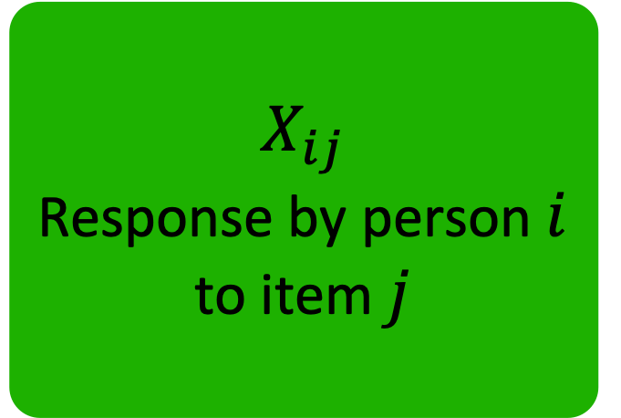
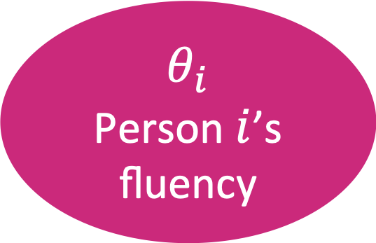
The 2-parameter Poisson counts model
$$θ_{i}$$
Person $i$’s
fluency
Exponential inverse link
$$X_{ij}$$
Response by person $i$ to item $j$
$$a_{j}$$
Item $j$’s discrimination
$$b_{j}$$
Item $j$’s
easiness
Poisson probability distribution
$$X_{ij}∼\text{Poisson}[exp(a_{j}θ_{i}+b_{j})]$$

Slide 53
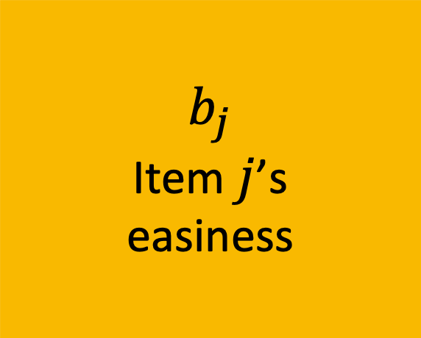
The 2-parameter Poisson counts model
$$θ_{i}$$
Person $i$’s
fluency
Exponential inverse link
$$X_{ij}$$
Response by person $i$ to item $j$
$$a_{j}$$
Item $j$’s discrimination
$$b_{j}$$
Item $j$’s
easiness
Poisson probability distribution
$$X_{ij}∼\text{Poisson}[exp(a_{j}θ_{i}+b_{j})]$$

Slide 54
All the benefits of IRT
Unlocking the benefits of modern test theory for more tasks
Better account of reliability (Myszkowski & Storme, 2025)
Gain in accuracy from average scoring (Myszkowski, 2024)
Multidimensional extensions (Myszkowski & Storme, 2021; Myszkowski, 2024)
And other IRT things…
missing data, matrix sampling, measurement invariance testing, optimal test assembly, computer adaptive testing, etc.

Slide 55
Boosting reliability with distractors:
Nested logit models
Notes:
20 MIN

Slide 56
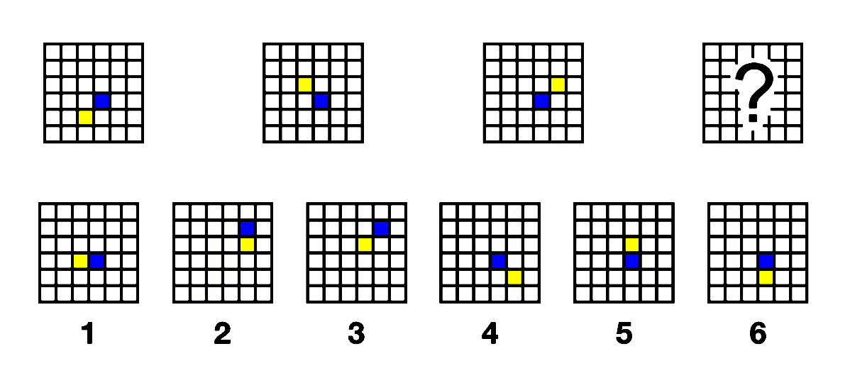
Storme, Myszkowski, Baron & Bernard, 2020

Slide 57
Storme, Myszkowski, Baron & Bernard, 2020

Slide 58
Equally incorrect?
Storme, Myszkowski, Baron & Bernard, 2020

Slide 59
From categorical to binary
Problem-solving
Correct
Distractor 1
Distractor 2
Distractor 3
Distractor 4
Distractor 5
Pass (1)
Fail (0)

Slide 60
From categorical to binary
Problem-solving
Correct
Distractor 1
Distractor 2
Distractor 3
Distractor 4
Distractor 5
Pass (1)
Fail (0)

Slide 61
From categorical to binary
Problem-solving
Guessing
Correct
Distractor 1
Distractor 2
Distractor 3
Distractor 4
Distractor 5
Pass (1)
Fail (0)

Slide 62
Nested logit models
(Suh & Bolt, 2010)
Correct vs. incorrect
Person’s ability
Binary logistic model (e.g., 3PL)
Distractor comparison
Nominal response model
(2PL generalized to more than 2 categories)
Correct
Distractor 1
Distractor 2
Distractor 3
Distractor 4
Distractor 5

Slide 63
Nested logit models
(Suh & Bolt, 2010)
Correct vs. incorrect
Person’s ability
Binary logistic model (e.g., 3PL)
Distractor comparison
Nominal response model
(2PL generalized to more than 2 categories)
Correct
Distractor 1
Distractor 2
Distractor 3
Distractor 4
Distractor 5

Slide 64
Nested logit models
(Suh & Bolt, 2010)
Correct vs. incorrect
Person’s ability
Binary logistic model (e.g., 3PL)
Distractor comparison
Nominal response model
(2PL generalized to more than 2 categories)
Correct
Distractor 1
Distractor 2
Distractor 3
Distractor 4
Distractor 5

Slide 65
Nested logit models
(Suh & Bolt, 2010)
Correct vs. incorrect
Person’s ability
Binary logistic model (e.g., 3PL)
Information
Distractor comparison
More information !
Nominal response model
(2PL generalized to more than 2 categories)
Correct
Distractor 1
Distractor 2
Distractor 3
Distractor 4
Distractor 5

Slide 66
Nested logit models
(Suh & Bolt, 2010)
Correct vs. incorrect
Person’s ability
Binary logistic model (e.g., 3PL)
Information
Distractor comparison
More information !
Nominal response model
(2PL generalized to more than 2 categories)
Correct
Distractor 1
Distractor 2
Distractor 3
Distractor 4
Distractor 5

Slide 67
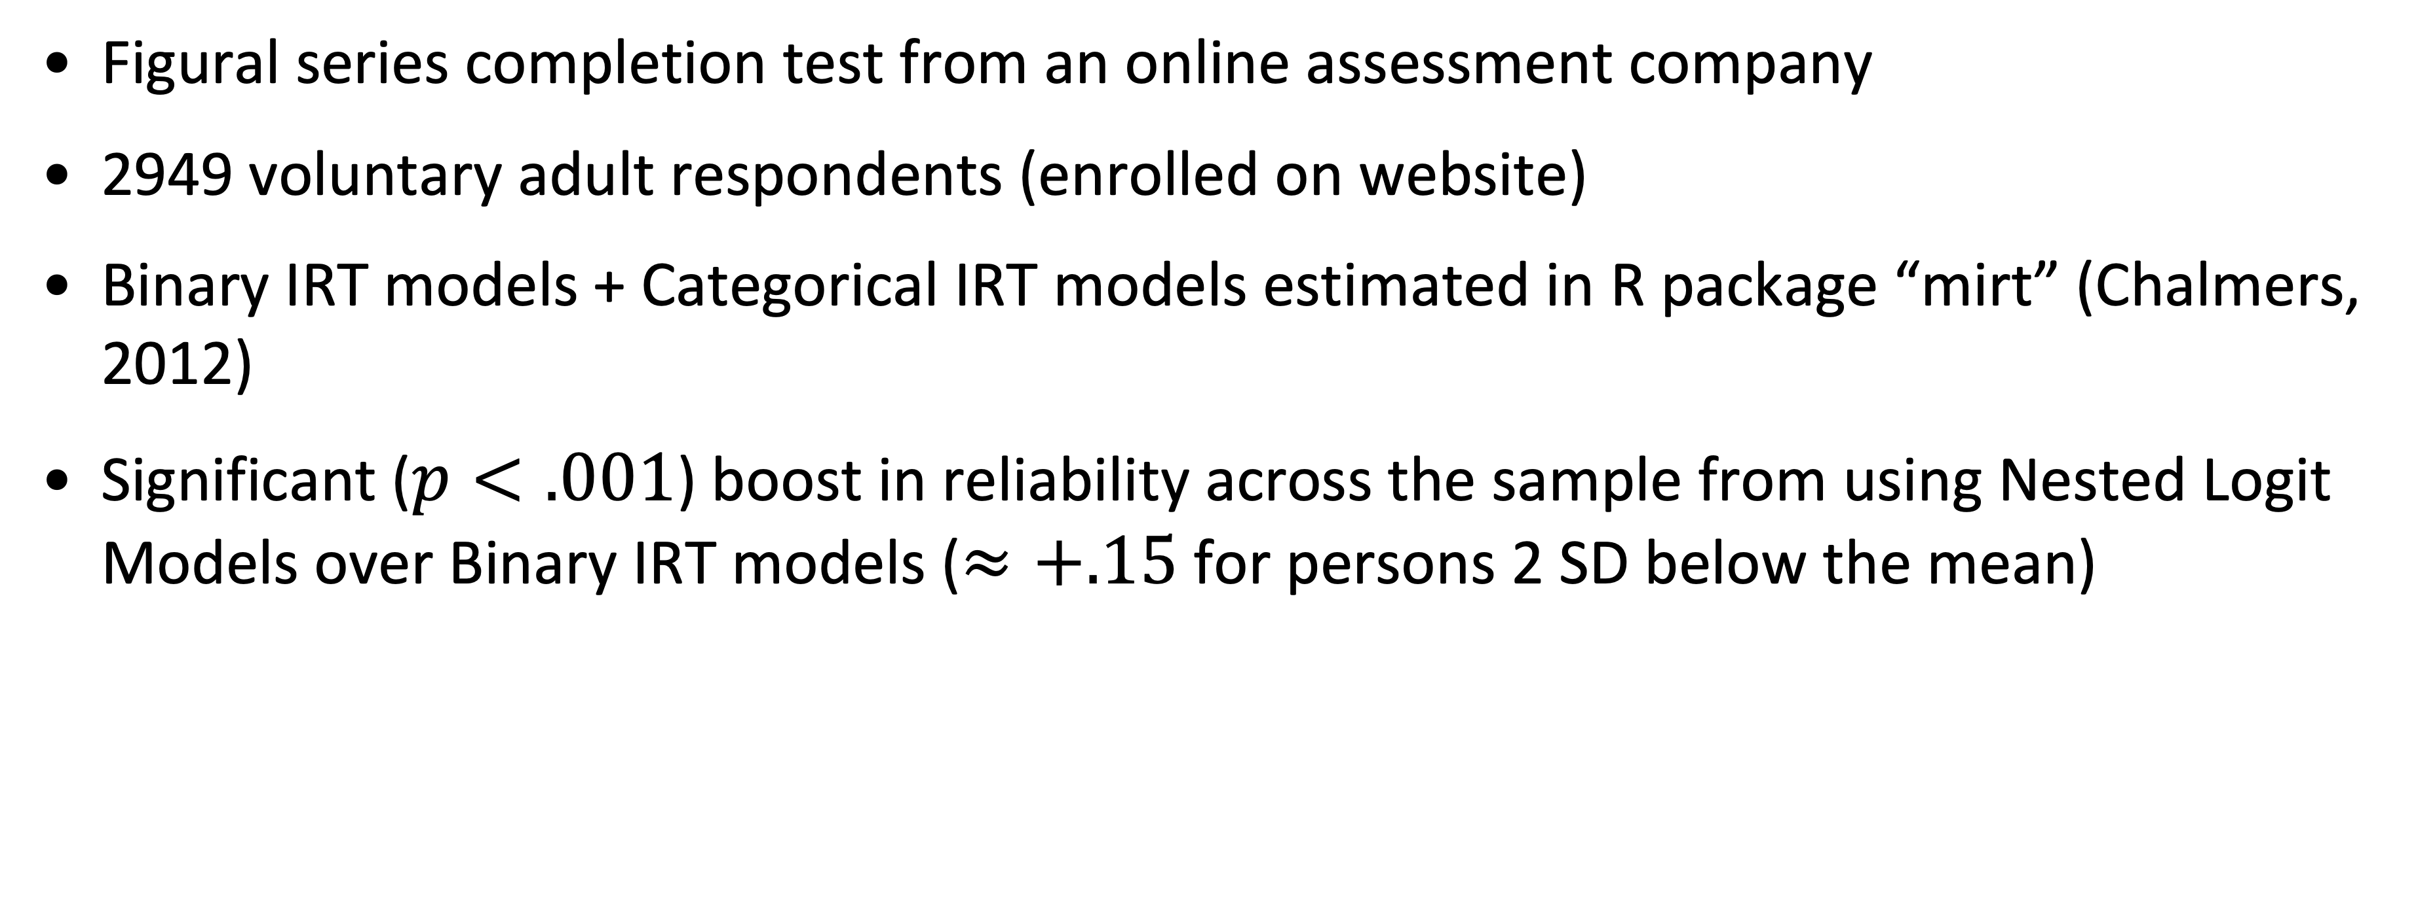
Example 1 : Figural series completion test
(Storme, Myszkowski, Baron & Bernard, 2020)
Figural series completion test from an online assessment company
2949 voluntary adult respondents (enrolled on website)
Binary IRT models + Categorical IRT models estimated in R package “mirt” (Chalmers, 2012)
Significant ($p<.001$) boost in reliability across the sample from using Nested Logit Models over Binary IRT models ($≈+.15$ for persons 2 SD below the mean)

Slide 68
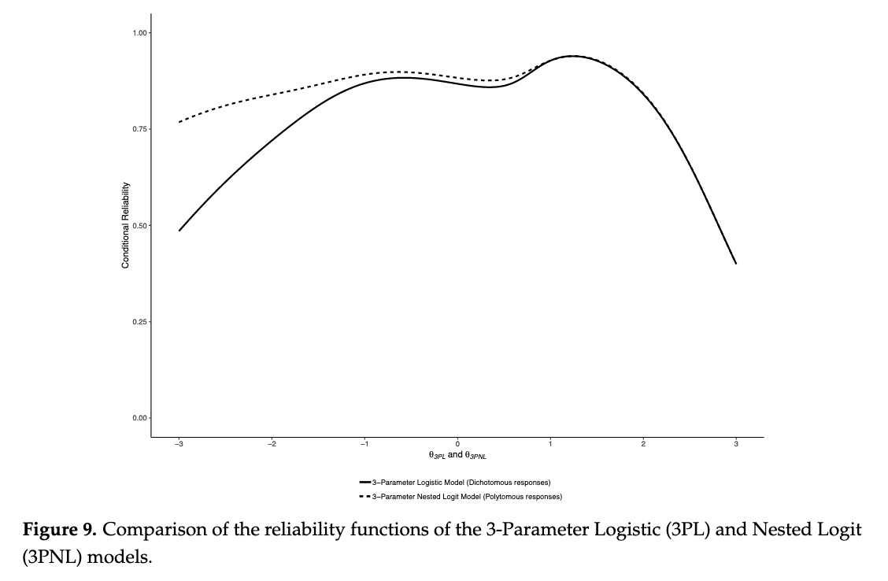
Storme, Myszkowski, Baron & Bernard, 2020

Slide 69
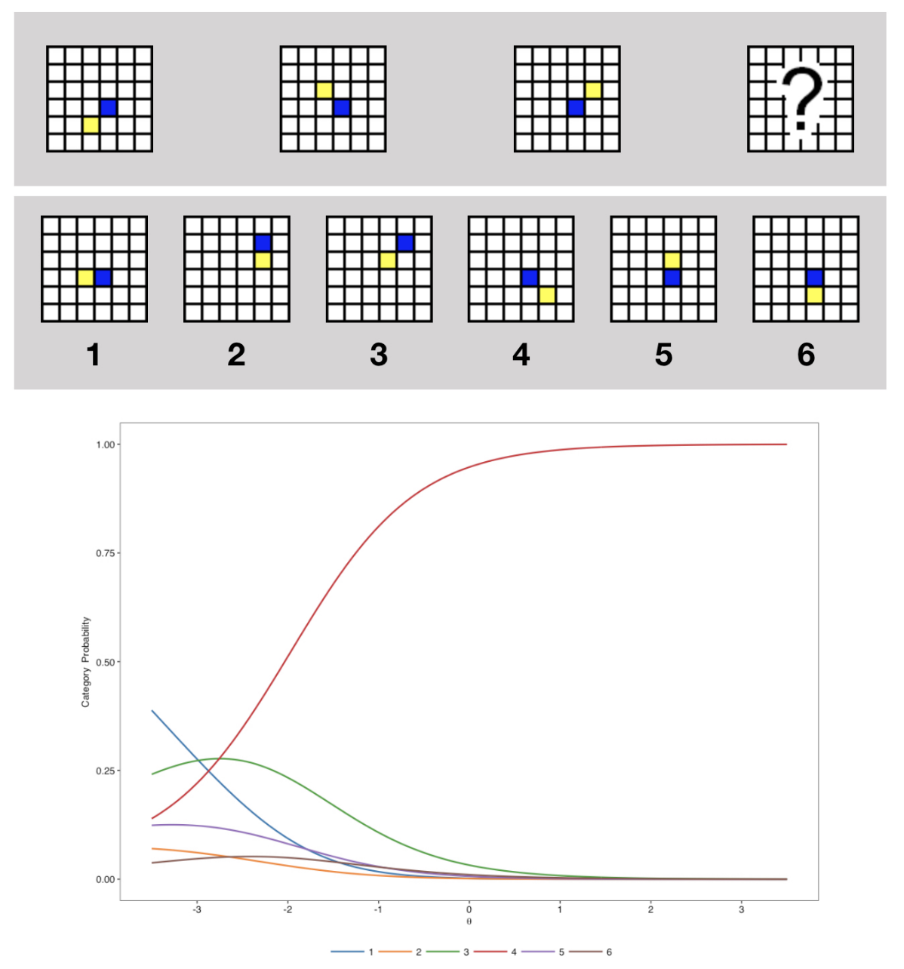
Storme, Myszkowski, Baron & Bernard, 2020

Slide 70
Correct
Storme, Myszkowski, Baron & Bernard, 2020

Slide 71
A “worse”
distractor choice ?
Correct
A “better” distractor choice ?
(Rarely picked)
Storme, Myszkowski, Baron & Bernard, 2020

Slide 72
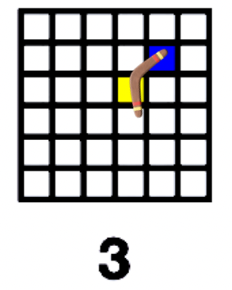
🪃
🪃
🪃
🪃
Storme, Myszkowski, Baron & Bernard, 2020

Slide 73
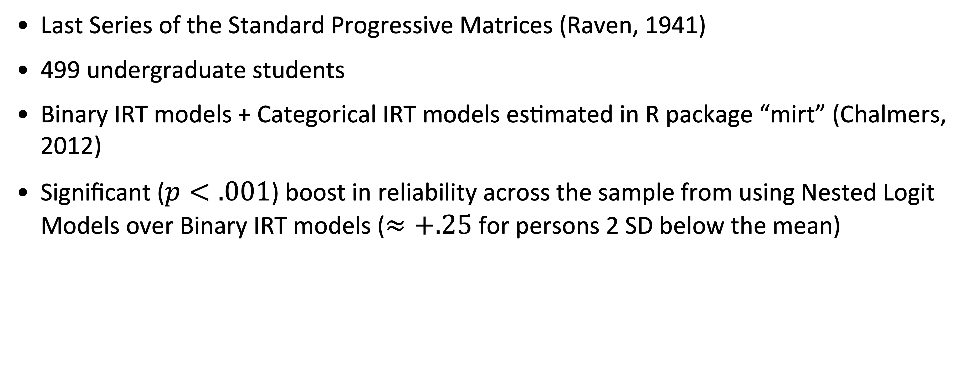
Example 2 : Progressive Matrices
(Myszkowski & Storme, 2018)
Last Series of the Standard Progressive Matrices (Raven, 1941)
499 undergraduate students
Binary IRT models + Categorical IRT models estimated in R package “mirt” (Chalmers, 2012)
Significant ($p<.001$) boost in reliability across the sample from using Nested Logit Models over Binary IRT models ($≈+.25$ for persons 2 SD below the mean)

Slide 74
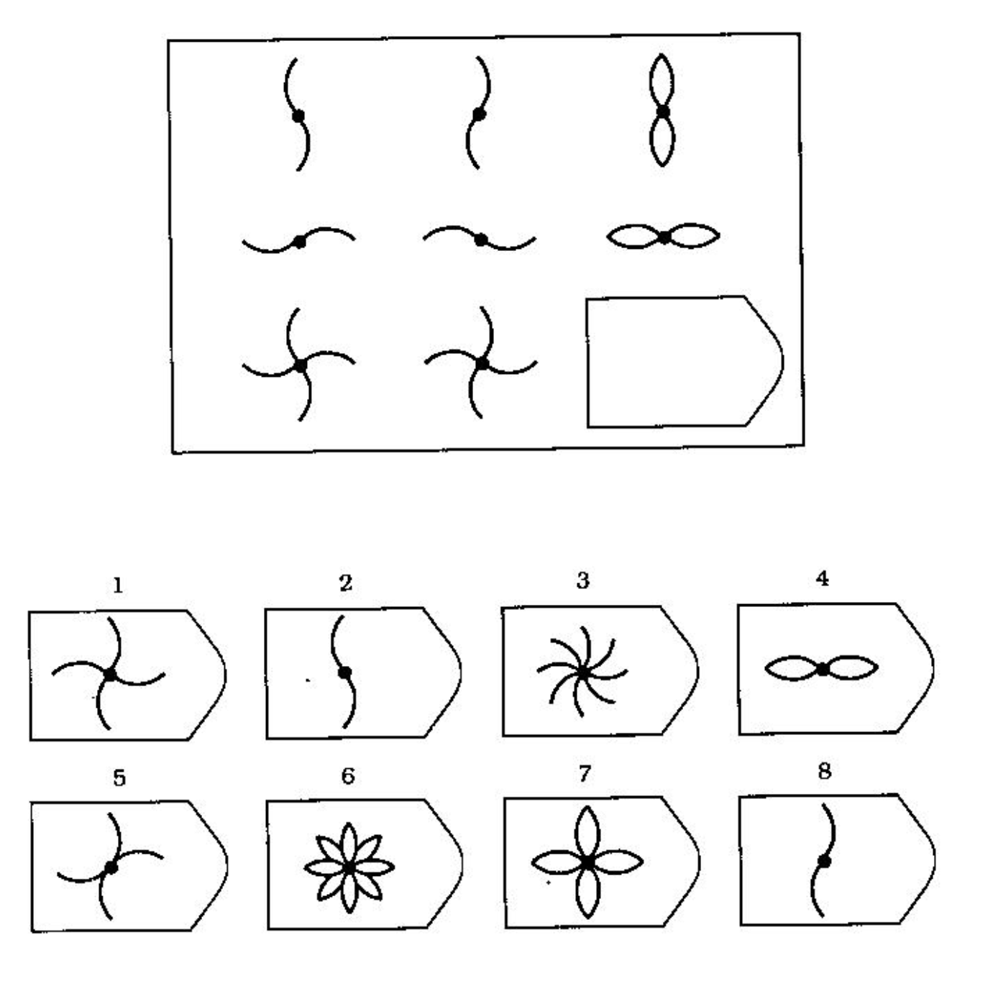
Raven, 1941

Slide 75
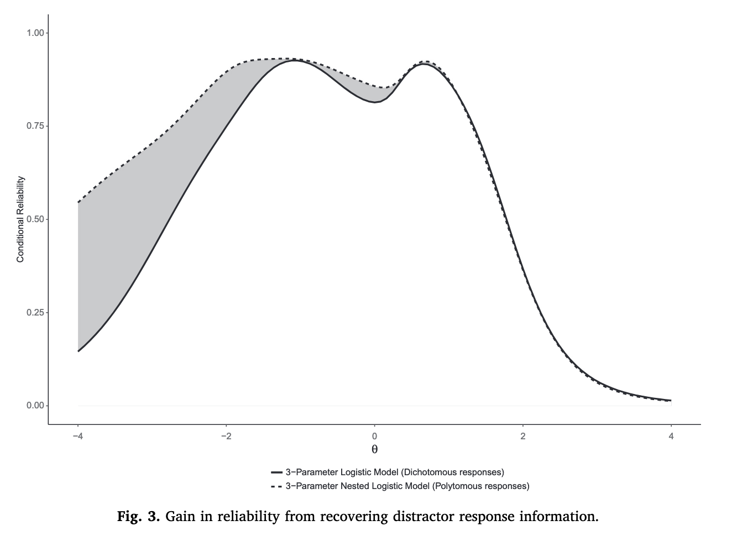
Myszkowski & Storme, 2018

Slide 76
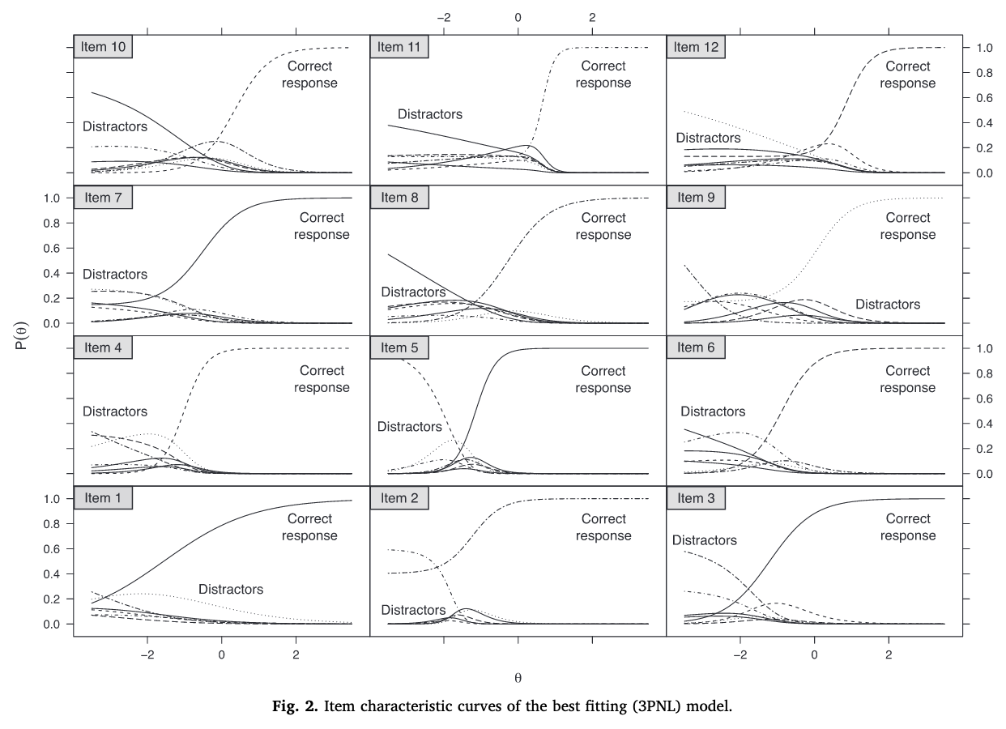
Myszkowski & Storme, 2018

Slide 78
Extending response models
To maximize information
By using distractor responses, we can…
Make tests more reliable at lower levels (great for shorter diagnostic tests)
Identify distractors that might deserve partial credit
Identify ambiguous items

Slide 79
Disentangling response processes:
IRTree models
Notes:
26 MIN

Slide 80
Breaking down test responses
Psychological attribute
Decision 1
Psychological attribute
Psychological attribute
Decision 2A
Decision 2B
Response category 1
Response category 2
Response category 3
Response category 4
Response category 5
Response category 6

Slide 81
IRT + Decision tree = IRTree
(De Boeck & Partchev, 2012)

Slide 82
Example 1 : Disentangling ratings
(Myszkowski & Storme, 2025)
IRT model proposition for OECD’s Programme for International Student Assessment (PISA) Creative Thinking 2022 data
Students produce a creative solution to open-ended problems (e.g., imagine a dialogue for a situation)
Creativity rated :
0 : No credit
1: Partial credit
2: Full credit
Treated as ordinal in PISA scorings.

Slide 83
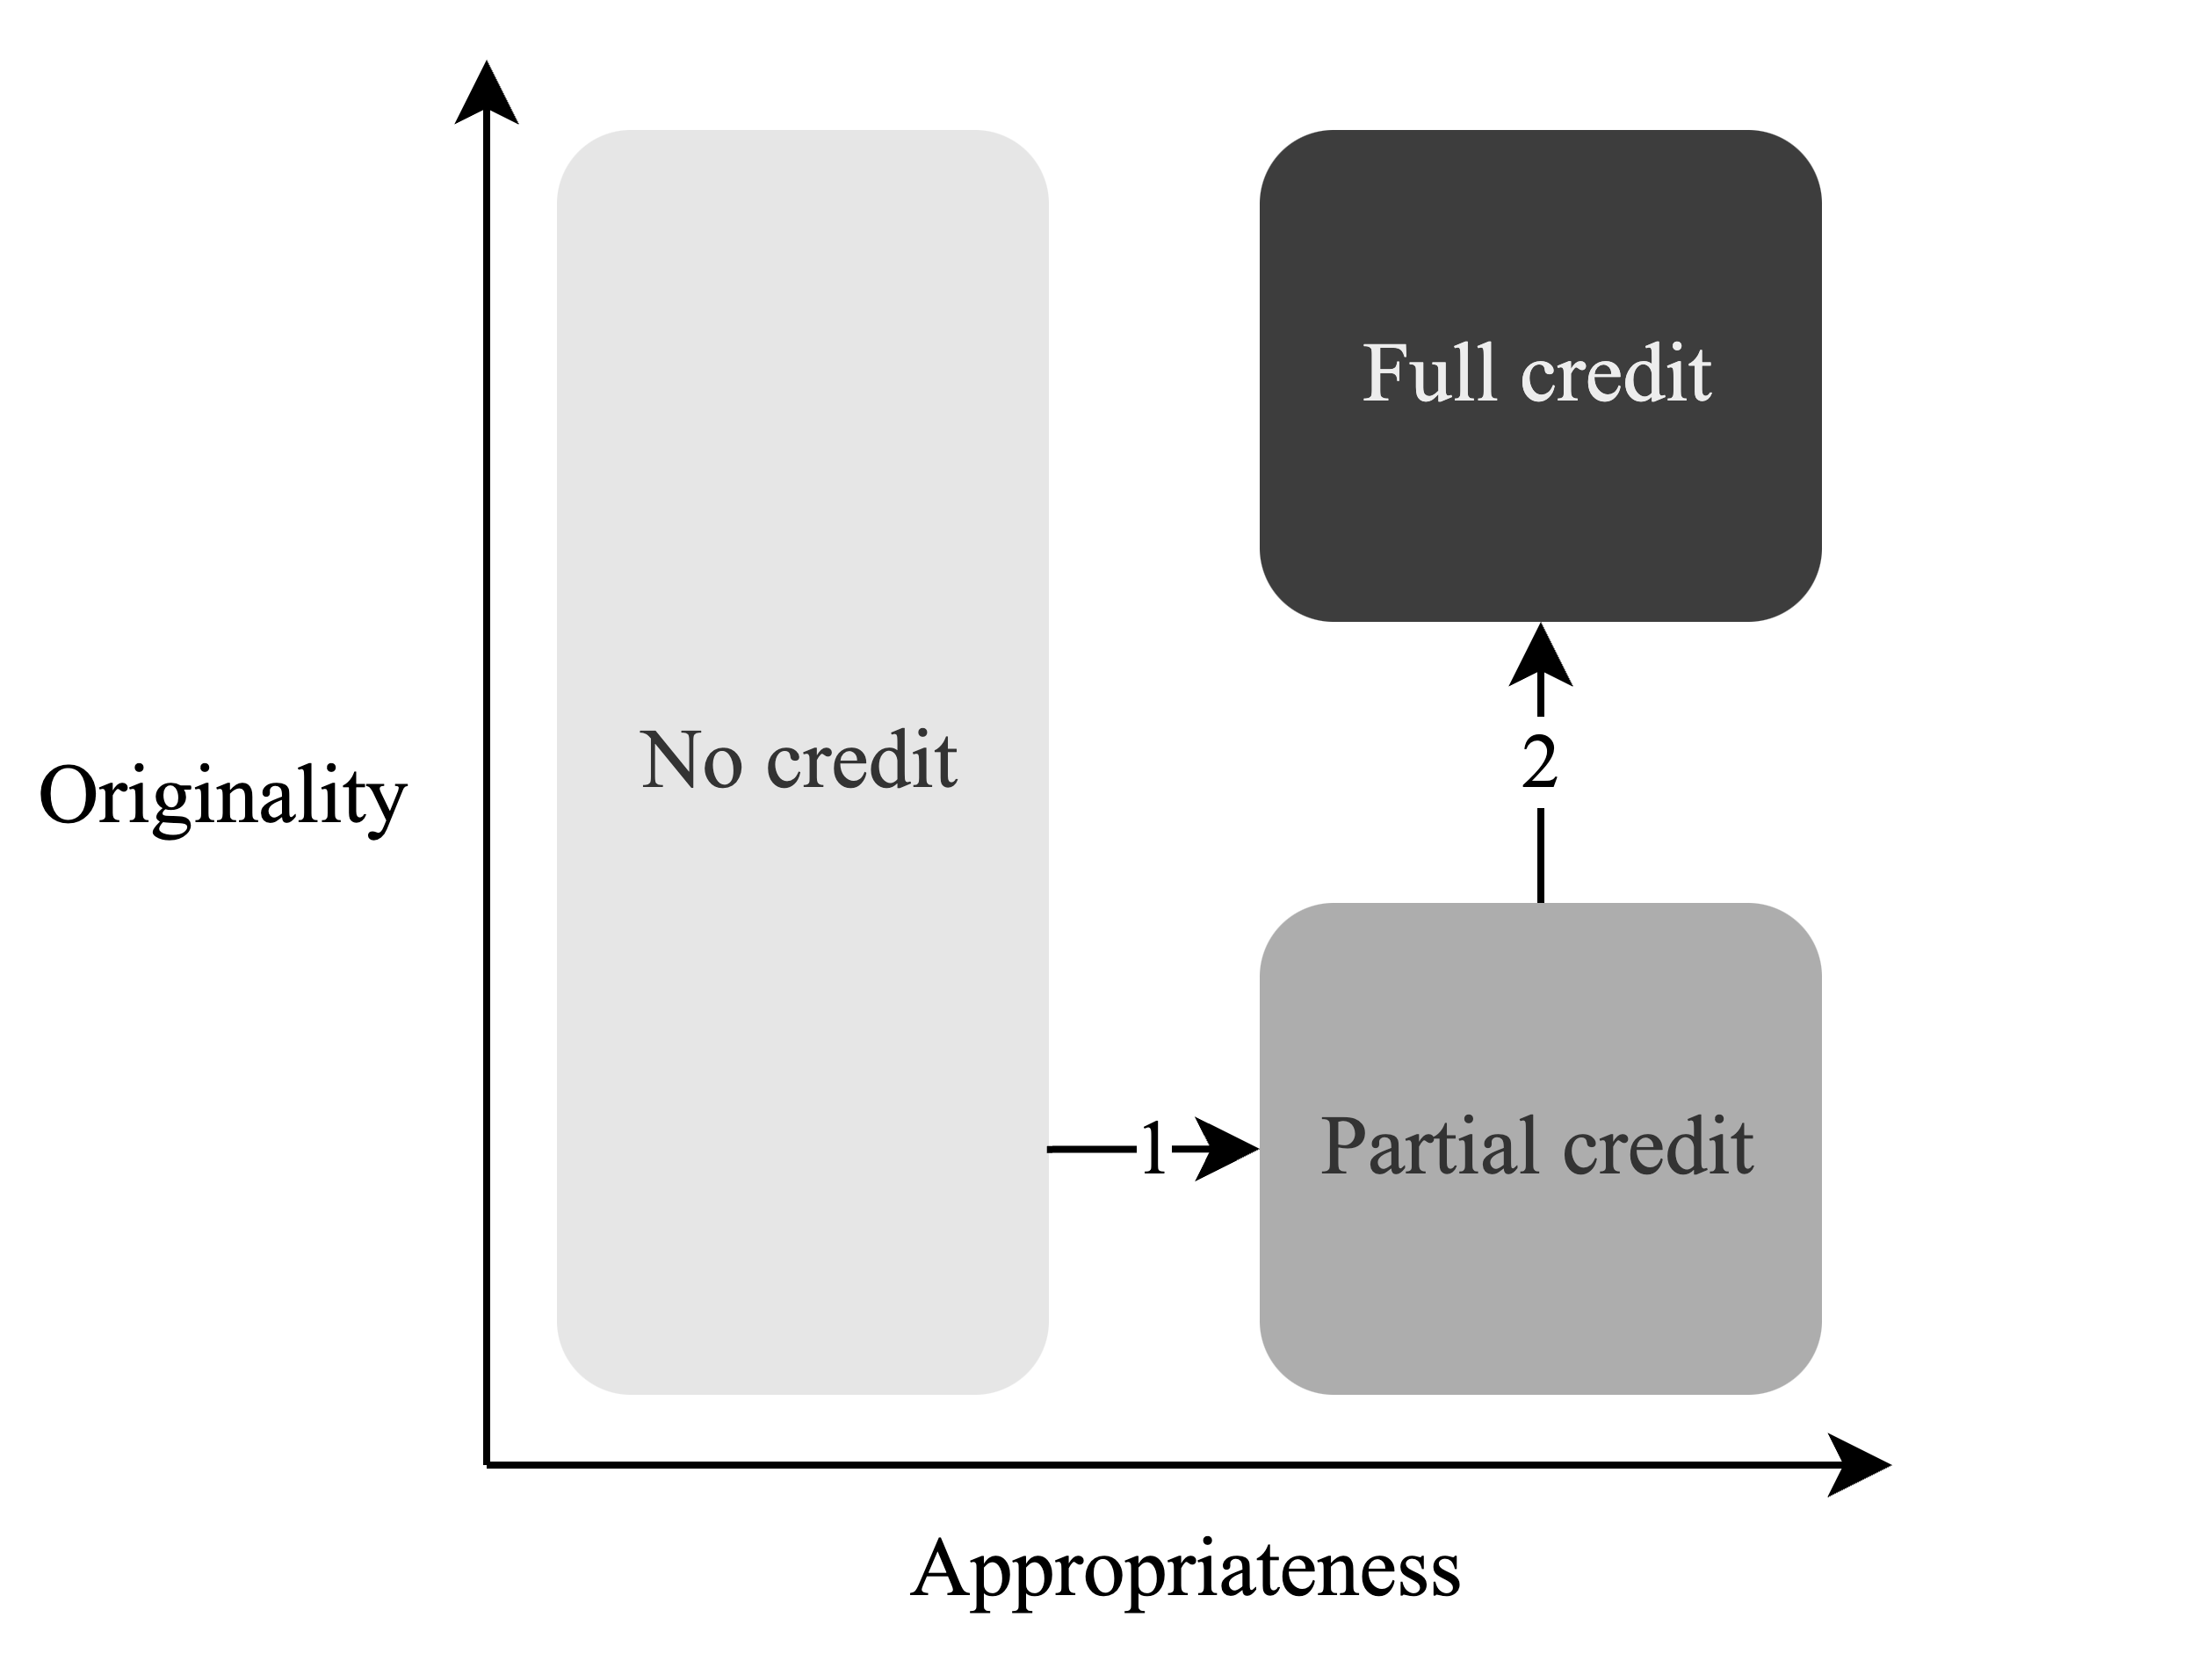
Myszkowski & Storme, 2025

Slide 84
Disentangling creativity components
Appropriateness
Decision 1
(no credit vs. any credit)
Originality
Decision 2
(partial vs. full)
No credit
Partial
credit
Full credit

Slide 85
Disentangling creativity components
Appropriateness
Decision 1
(no credit vs. any credit)
Originality
Decision 2
(partial vs. full)
No credit
Partial
credit
Full credit

Slide 86
Disentangling creativity components
Appropriateness
Decision 1
(no credit vs. any credit)
Originality
Decision 2
(partial vs. full)
No credit
Partial
credit
Full credit

Slide 87
Disentangling creativity components
Appropriateness
Decision 1
(no credit vs. any credit)
Originality
Decision 2
(partial vs. full)
No credit
Partial
credit
Full credit

Slide 88
Advantages
More realistic (we don’t pretend to have measured the originality of all products)
Disentangle 2 traits underlying the ratings (and their structure)
Better understanding of relations with other variables (e.g., reading ability might be better related to appropriateness than originality)

Slide 89
Example 2 : Capturing trait intensity
(Storme, Çelik & Myszkowski, 2020)
452 undergraduates
Big Five Inventory (BFI, John & Srivastava, 1999)
Measure of trait levels and trait intensity with the trait variability tree model (TVTM; Lang et al., 2019)
Estimated in generalized linear multilevel regression (GLMM) framework with the R package “lme4” (Bates et al., 2015)
Career adapt-abilities scale (CAAS; Johnston et al., 2013)

Slide 90
Disentangling intensity and direction
Trait intensity
Pseudo-item 1
(neutral vs. not)
Trait direction
Pseudo-item 2
(low vs. high)
Pseudo-item 3
(extreme vs. not)
Pseudo-item 3
(extreme vs. not)
Extreme low response
Low
response
Neutral
High
response
Extreme high response

Slide 91
Disentangling intensity and direction
Trait intensity
Pseudo-item 1
(neutral vs. not)
Trait direction
Pseudo-item 2
(low vs. high)
Pseudo-item 3
(extreme vs. not)
Pseudo-item 3
(extreme vs. not)
Extreme low response
Low
response
Neutral
High
response
Extreme high response

Slide 92
Disentangling intensity and direction
Trait intensity
Pseudo-item 1
(neutral vs. not)
Trait direction
Pseudo-item 2
(low vs. high)
Pseudo-item 3
(extreme vs. not)
Pseudo-item 3
(extreme vs. not)
Extreme low response
Low
response
Neutral
High
response
Extreme high response

Slide 93
Disentangling intensity and direction
Trait intensity
Pseudo-item 1
(neutral vs. not)
Trait direction
Pseudo-item 2
(low vs. high)
Pseudo-item 3
(extreme vs. not)
Pseudo-item 3
(extreme vs. not)
Extreme low response
Low
response
Neutral
High
response
Extreme high response

Slide 94
Disentangling intensity and direction
Trait intensity
Pseudo-item 1
(neutral vs. not)
Trait direction
Pseudo-item 2
(low vs. high)
Pseudo-item 3
(extreme vs. not)
Pseudo-item 3
(extreme vs. not)
Extreme low response
Low
response
Neutral
High
response
Extreme high response

Slide 95
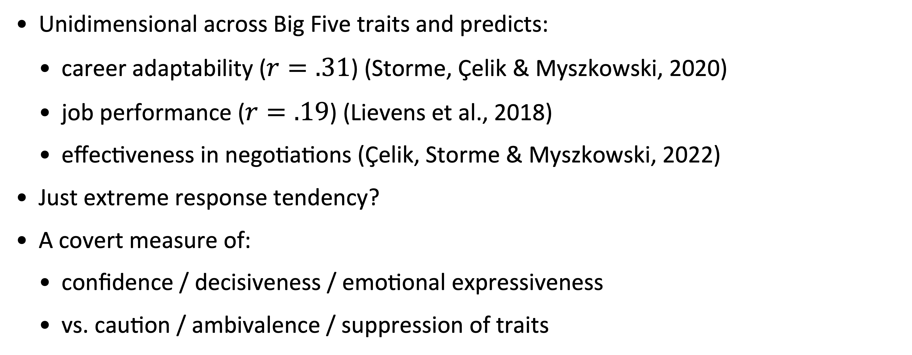
Trait intensity
Unidimensional across Big Five traits and predicts:
career adaptability ($r=.31$) (Storme, Çelik & Myszkowski, 2020)
job performance ($r=.19$) (Lievens et al., 2018)
effectiveness in negotiations (Çelik, Storme & Myszkowski, 2022)
Just extreme response tendency?
A covert measure of:
confidence / decisiveness / emotional expressiveness
vs. caution / ambivalence / suppression of traits

Slide 96
Going beyond answers:
Joint hierarchical models
Notes:
35 MIN

Slide 97
Test performance as an ensemble of behaviors
Test responses
(Pass/Fail, Likert scale, etc.)

Slide 98
Test performance as an ensemble of behaviors
Test behaviors
Physiological measures
🩺
Test responses
(Pass/Fail, Likert scale, etc.)
Skipping/returning to items
⏭️
Pointer movements
and keystrokes
⌨️
Eye movements
👀
Response times
⏱️
…

Slide 99
Example 1 : Speed-accuracy trade-off
(Myszkowski, 2019)
Revised version (Myszkowski & Storme, 2017) of the Visual Aesthetic Sensitivity Test (Götz, 1985)
201 undergraduate students
Collected responses and response times
Non-speeded test
Hypothesized that faster respondents are worse performers

Slide 100


Slide 101
Joint modeling approach
(van der Linden & Fox, 2016)
Person
ability
Person
speed
Item
difficulty
Item
discrimination
Item time-
difficulty (labor intensity)
Item
time-discrimination
Observations
Response (Pass/Fail)
Response time

Slide 102
Joint modeling approach
(van der Linden & Fox, 2016)
Person
ability
Person
speed
Item
difficulty
Item
discrimination
Item time-
difficulty (labor intensity)
Item
time-discrimination
Observations
Response (Pass/Fail)
Response time

Slide 103
Responses
Myszkowski (2024)

Slide 104
Joint modeling approach
(van der Linden & Fox, 2016)
Person
ability
Person
speed
Item
difficulty
Item
discrimination
Item time-
difficulty (labor intensity)
Item
time-discrimination
Observations
Response (Pass/Fail)
Response time

Slide 105
Response times
Myszkowski (2024)

Slide 106

Myszkowski, 2024

Slide 107
Joint modeling approach
(van der Linden & Fox, 2016)
Person
ability
Person
speed
Item
difficulty
Item
discrimination
Item time-
difficulty (labor intensity)
Item
time-discrimination
Observations
Response (Pass/Fail)
Response time

Slide 108
Joint modeling approach
(van der Linden & Fox, 2016)
Person
ability
Person
speed
More stable estimation
Item
difficulty
Item
discrimination
Item time-
difficulty (labor intensity)
Item
time-discrimination
Observations
Response (Pass/Fail)
Response time

Slide 109
Joint modeling approach
(van der Linden & Fox, 2016)
Person
ability
Person
speed
Item
difficulty
Item
discrimination
Item time-
difficulty (labor intensity)
Item
time-discrimination
Observations
Response (Pass/Fail)
Response time

Slide 110
Joint modeling approach
(van der Linden & Fox, 2016)
More information !
Person
ability
Person
speed
Item
difficulty
Item
discrimination
Item time-
difficulty (labor intensity)
Item
time-discrimination
Observations
Response (Pass/Fail)
Response time

Slide 111
Example 1 : Speed-accuracy trade-offs
(Myszkowski, 2019)
Responses: 2/3-parameter normal ogive model
Response times: 2-parameter lognormal model
Bayesian MCMC estimation using the R package LNIRT (Fox et al., 2007)
r = -.47 between speed and accuracy (95% HPD [−0.61, −0.32])

Slide 112
Example 2 : Speed trajectories
(Myszkowski, Storme, Kubiak & Baron, 2022)
Spatial reasoning test : Progressive matrices generated using IMak (Blum & Holling, 2018)
Big Five : Synthetic Aperture Personality Assessment (SAPA) (Revelle et al., 2010)
Analysis :
1/ Variable speed joint IRT model using LNIRT (Fox et al., 2007) for R
2/ Latent profile analysis of latent speed parameters using tidyLPA (Rosenberg et al., 2018) for R

Slide 113
Joint modeling approach
(van der Linden & Fox, 2016)
Person
ability
Person
speed
Item
difficulty
Item
discrimination
Item time-
difficulty (labor intensity)
Item
time-discrimination
Observations
Response (Pass/Fail)
Response time

Slide 114
Joint modeling approach
(van der Linden & Fox, 2016)
Person
ability
Person
speed
Item
difficulty
Item
discrimination
Item time-
difficulty (labor intensity)
Item
time-discrimination
Observations
Response (Pass/Fail)
Response time

Slide 115
Constant speed model
Constant
(intercept)
Constant
person
speed

Slide 116
Dynamic speed model
Starting speed
(intercept)
Linear speed component
(acceleration)
Quadratic speed component
(change in acceleration)
Dynamic
person
speed

Slide 117
Dynamic speed model
Latent profile analysis
Starting speed
(intercept)
Linear speed component
(acceleration)
Quadratic speed component
(change in acceleration)
Dynamic
person
speed

Slide 118

(Myszkowski, Storme, Kubiak & Baron, 2022)

Slide 119
Hasty
(Myszkowski, Storme, Kubiak & Baron, 2022)

Slide 120
Precautious
(Myszkowski, Storme, Kubiak & Baron, 2022)

Slide 121
Absorbed
(Myszkowski, Storme, Kubiak & Baron, 2022)

Slide 122
Hasty
Absorbed
Precautious
(Myszkowski, Storme, Kubiak & Baron, 2022)

Slide 123


Hasty
Absorbed
Precautious

Slide 124

(Myszkowski, Storme, Kubiak & Baron, 2022)

Slide 125
(Myszkowski, Storme, Kubiak & Baron, 2022)

Slide 126


(Myszkowski, Storme, Kubiak & Baron, 2022)

Slide 127
Example 2 : Personality and test taking
(Myszkowski, Storme, Kubiak & Baron, 2022)
Big five trait differences across trajectory types (One-Way MANOVA; p<.001)
“Hasty” (18% cases): low openness, low emotional stability
“Absorbed” (53% cases): low agreeableness, high openness
“Precautious” (29% cases): high agreeableness, high conscientiousness

Slide 128
Conclusions
Collateral information allows…
To increase reliability (or to use fewer items)
To study and measure various psychological processes (e.g., engagement) going on during the test
To control for them
To detect unexpected test behavior (e.g., guessing, cheating)

Slide 129
Conclusions
(and unsolicited advice)
Notes:
45 MIN

Slide 130
Some important considerations for assessment
All psychological testing situations are unique.
Various response formats (discrete, bounded, etc.)
Multiple decisions / strategies involved in responses
Different traits involved in these decisions
Other observable behaviors than the response
The modern test theory framework allows to accommodate a lot of quirks and messy situations !

Slide 131
Psychologist
Psychometrician
motivates
Psychometric theory
Psychometric model
Statistical analysis

Slide 132
Psychologist
Psychometrician
motivates
Psychometric theory
Psychometric model
Psychology first !
Statistical analysis

Slide 133
Upcoming projects

Slide 134
Manuscripts in revision
Meta-analysis on critical thinking - creative thinking in education (student 1st author, Thinking Skills and Creativity)
Large-scale algebra test development (co-author, Journal for Research in Mathematics Education)

Slide 135
Manuscripts in preparation for 2025
PISA Creative Thinking
Empirical application of IRTree (1st author, Thinking Skills and Creativity)
General IRT critique (1st author, Creativity Research Journal)
General psychometric critique (co-author, Creativity Research Journal)
IRT analysis on the impact of early stopping rules in cognitive assessment using large-scale data (student 1st author, journal TBD)
Dynamic measurement of creativity through the originality-appropriateness trade-off (1st author, journal TBD)

Slide 136
Grant projects
Co-PI on NSF EDU-Core grant to be concluded in 2025
Team currently working on publishing results and possibly reapply for a new grant
Fall 2025 : Grant for experiment on creative mindsets
APA – Division 10 Micro-Grant
2026 : Grant for the development of an R library to facilitate PISA data scoring
IES – Statistical and Research Methodology in Education | 84.305D
2026/2027 : Development of a tool for large-scale measurement of creativity in students in the US
NSF – EDU Core Research | 21–588

Slide 137
References
Beisemann, M. (2022). A flexible approach to modelling over-, under- and equidispersed count data in IRT: The Two-Parameter Conway-Maxwell-Poisson Model. The British Journal of Mathematical and Statistical Psychology, 75(3), 411–443. https://doi.org/10.1111/bmsp.12273
Birnbaum, A., Lord, F. M., & Novick, M. R. (1968). Some latent trait models and their use in inferring an examinee’s ability. In Statistical theories of mental test scores (pp. 397–472). Addison Wesley.
De Ayala, R. J. (2022). The theory and practice of item response theory (Second edition). The Guilford Press.
De Boeck, P., & Partchev, I. (2012). IRTrees: Tree-Based Item Response Models of the GLMM Family. Journal of Statistical Software, 48(1), 1–28. https://doi.org/10.18637/jss.v048.c01
Forthmann, B., Bürkner, P.-C., Szardenings, C., Benedek, M., & Holling, H. (2019). A New Perspective on the Multidimensionality of Divergent Thinking Tasks. Frontiers in Psychology, 10. https://doi.org/10.3389/fpsyg.2019.00985
Fox, J.-P., Klein Entink, R. H., & van der Linden, W. J. (2007). Modeling of Responses and Response Times with the Package CIRT. Journal of statistical software, 20(7), 1–14.
Götz, K. O. (1985). VAST: Visual Aesthetic Sensitivity Test (4th ed.). Concept Verlag.
Lang, J. W. B., Lievens, F., De Fruyt, F., Zettler, I., & Tackett, J. L. (2019). Assessing meaningful within-person variability in Likert-scale rated personality descriptions: An IRT tree approach. Psychological Assessment, 31(4), 474–487. https://doi.org/10.1037/pas0000600
Lievens, F., Lang, J. W. B., De Fruyt, F., Corstjens, J., Van de Vijver, M., & Bledow, R. (2018). The predictive power of people’s intraindividual variability across situations: Implementing whole trait theory in assessment. Journal of Applied Psychology, 103(7), 753–771. https://doi.org/10.1037/apl0000280
Myszkowski, N. (2019). The first glance is the weakest: “Tasteful” individuals are slower to judge visual art. Personality and Individual Differences, 141, 188–195. https://doi.org/10.1016/j.paid.2019.01.010
Myszkowski, N. (2021). Development of the R library “jrt”: Automated item response theory procedures for judgment data and their application with the consensual assessment technique. Psychology of Aesthetics, Creativity, and the Arts, 15(3), 426–438. https://doi.org/10.1037/aca0000287
Myszkowski, N., & Storme, M. (2017). Measuring “good taste” with the Visual Aesthetic Sensitivity Test-Revised (VAST-R). Personality and Individual Differences, 117, 91–100. https://doi.org/10.1016/j.paid.2017.05.041
Myszkowski, N., & Storme, M. (2018). A snapshot of g? Binary and polytomous item-response theory investigations of the last series of the Standard Progressive Matrices (SPM-LS). Intelligence, 68, 109–116. https://doi.org/10.1016/j.intell.2018.03.010
Myszkowski, N., & Storme, M. (2019). Judge response theory? A call to upgrade our psychometrical account of creativity judgments. Psychology of Aesthetics, Creativity, and the Arts, 13(2), 167–175. https://doi.org/10.1037/aca0000225
Myszkowski, N., & Storme, M. (2021). Accounting for Variable Task Discrimination in Divergent Thinking Fluency Measurement: An Example of the Benefits of a 2-Parameter Poisson Counts Model and its Bifactor Extension Over the Rasch Poisson Counts Model. The Journal of Creative Behavior, 55(3), 800–818. https://doi.org/10.1002/jocb.490
Myszkowski, N., Storme, M., Kubiak, E., & Baron, S. (2022). Exploring the associations between personality and response speed trajectories in low-stakes intelligence tests. Personality and Individual Differences, 191(111580), 1–9. https://doi.org/10.1016/j.paid.2022.111580
Raven, J. C. (1941). Standardization of Progressive Matrices, 1938. British Journal of Medical Psychology, 19(1), 137–150. https://doi.org/10.1111/j.2044-8341.1941.tb00316.x
Silvia, P. J., Winterstein, B. P., Willse, J. T., Barona, C. M., Cram, J. T., Hess, K. I., Martinez, J. L., & Richard, C. A. (2008). Assessing creativity with divergent thinking tasks: Exploring the reliability and validity of new subjective scoring methods. Psychology of Aesthetics, Creativity, and the Arts, 2, 68–85. https://doi.org/10.1037/1931-3896.2.2.68
Storme, M., Celik, P., & Myszkowski, N. (2020). A forgotten antecedent of career adaptability: A study on the predictive role of within-person variability in personality. Personality and Individual Differences, 160, 1–6. https://doi.org/10.1016/j.paid.2020.109936
Storme, M., Myszkowski, N., Baron, S., & Bernard, D. (2019). Same Test, Better Scores: Boosting the Reliability of Short Online Intelligence Recruitment Tests with Nested Logit Item Response Theory Models. Journal of Intelligence, 7(3), 1–17. https://doi.org/10.3390/jintelligence7030017
Suh, Y., & Bolt, D. M. (2010). Nested Logit Models for Multiple-Choice Item Response Data. Psychometrika, 75(3), 454–473. https://doi.org/10.1007/s11336-010-9163-7
van der Linden, W. J., & Fox, J.-P. (2016). Joint Hierarchial Modeling of Responses and Response Times. In Handbook of Item Response Theory, Volume One: Models (1st ed., pp. 481–500). Chapman and Hall/CRC. https://doi.org/10.1201/9781315374512

Slide 138
Thank you !

